Slide 1
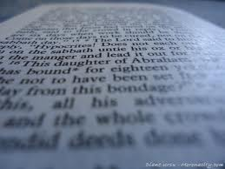
Lectio Divina
"If the practice of Lectio Divina is promoted with efficacy,
I am convinced that it will produce a
new spiritual springtime in the Church."
Pope Benedict XVI on 11-16-05

Slide 2
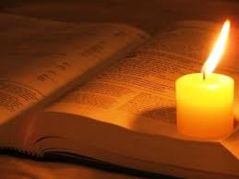
Lec-see-o Di-vee-na
Means “Divine Reading”
Method of reading
Scripture
Began with the monks

Slide 3
Step 1: Lectio
Read the passage
Value each word and phrase
Read the passage until a word or phrase touches you, attracts you, or disturbs you

Slide 4
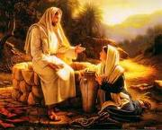
Step 2: Meditatio
Meditate on your word or phrase
Let the word sink in slowly
Repeat the word or phrase over and over slowly to see what God is trying to say to you through it

Slide 5
Step 3: Oratio
Pray over the reading
Express to God prayers that come spontaneously within you

Slide 6
Step 4: Contemplatio
Contemplate
Rest silently with God in stillness
Lift your heart to God!

Slide 7
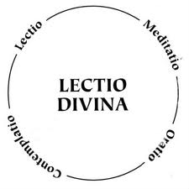

Slide 8
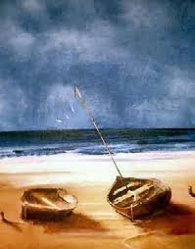
Begin with Luke 5:1-11
The Call of
Simon the Fisherman

