Slide 1
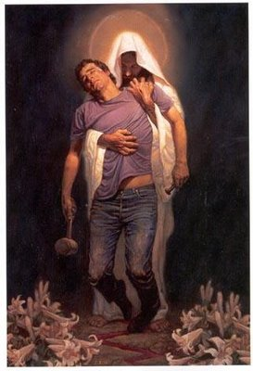
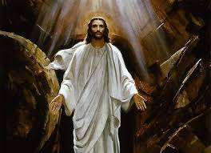
Safe Environment
Grades 7-9
April
2016

Slide 2
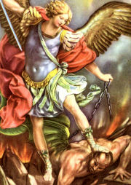
Saint Michael the Archangel
Opening Prayer
St. Michael the Archangel,
defend us in battle.
Be our defense against the
wickedness and snares of the Devil.
May God rebuke him, we humbly pray, and do thou,
O Prince of the heavenly hosts,
by the power of God,
thrust into hell Satan,
and all the evil spirits,
who prowl about the world
seeking the ruin of souls. Amen

Slide 3
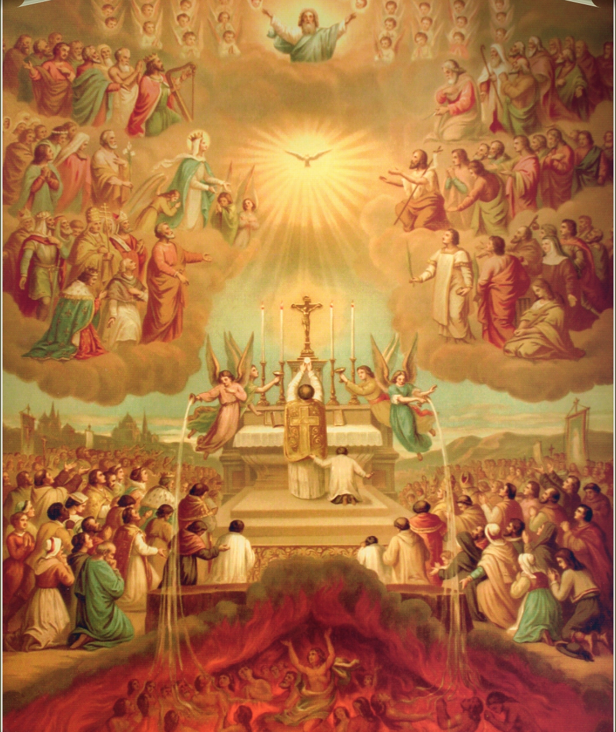
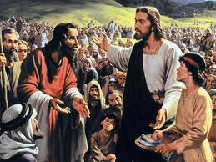
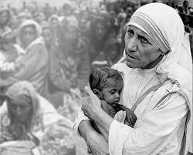
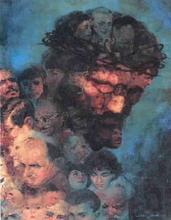
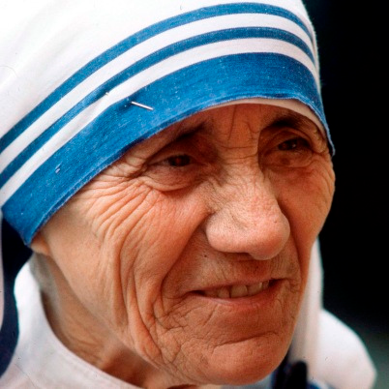
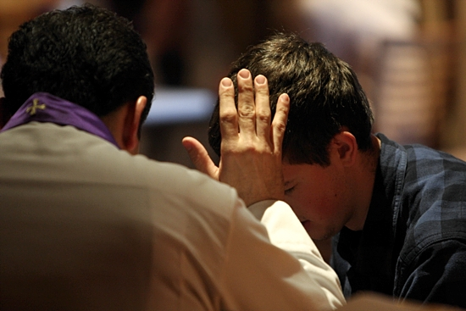
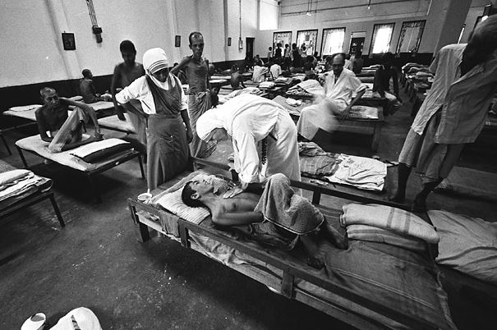
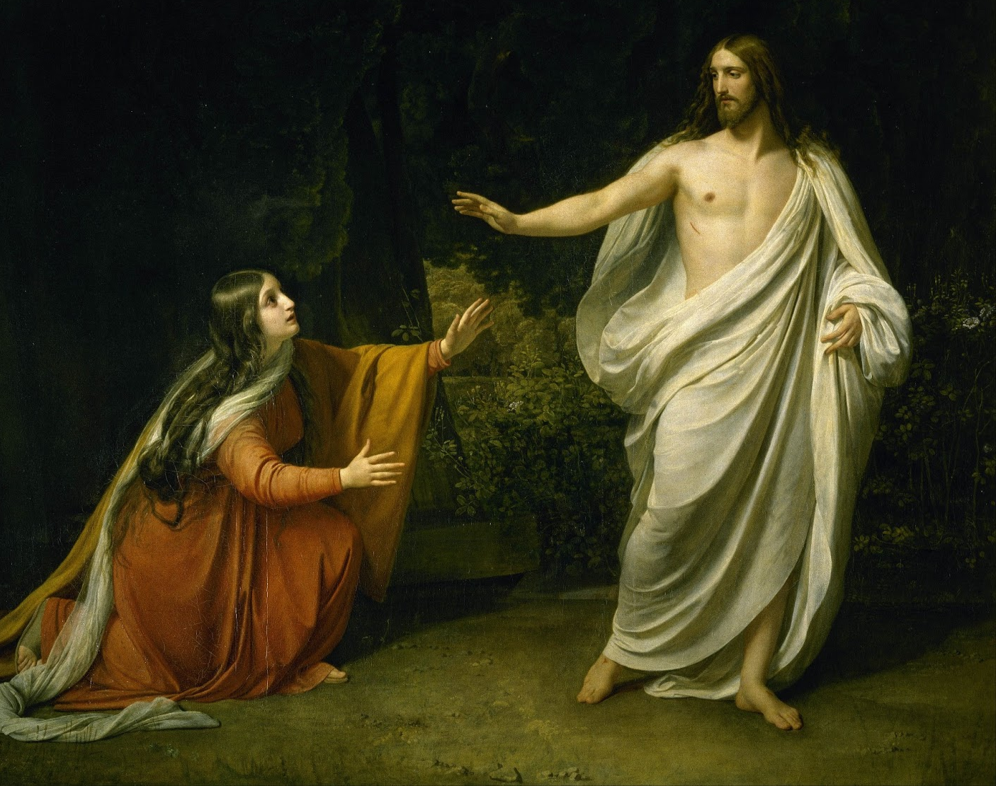
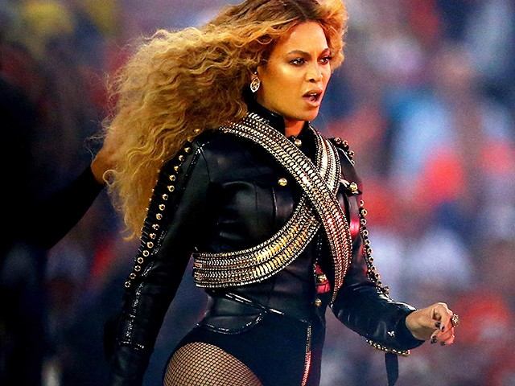
recognize that we are the Body of Christ
Treat Others As You Treat Yourself
Mystical Body of Christ - Sisters and Brothers
Corporal Works of Mercy
Spiritual Works of Mercy
Virtue
Charity - the act of giving either in the form of money, food, prayer, or other kinds of help to people who are poor, sick, etc.
Saint
Blessed/Saint Mother Teresa of Calcutta

Slide 4
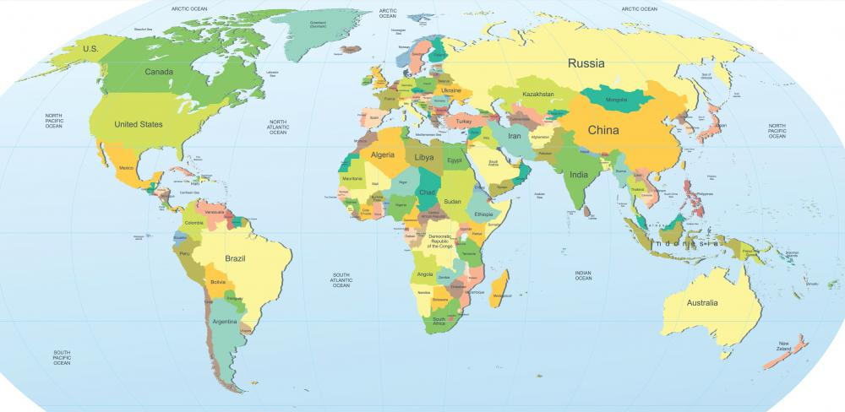
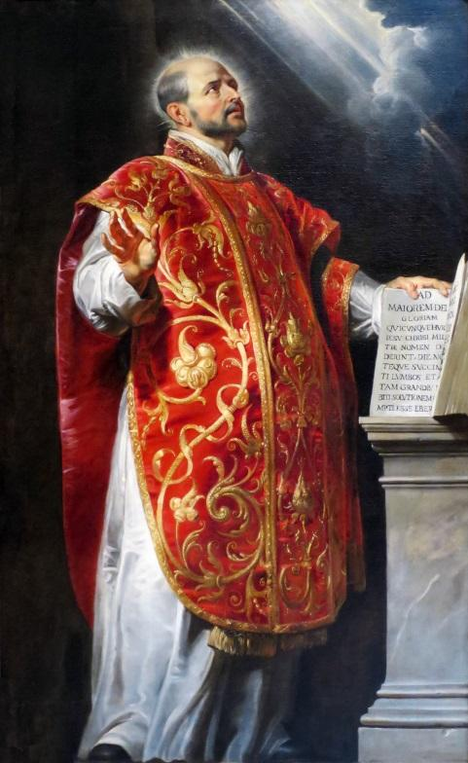
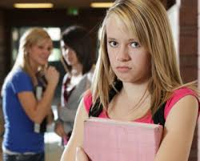
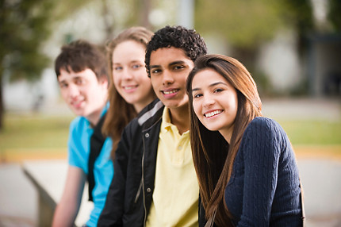
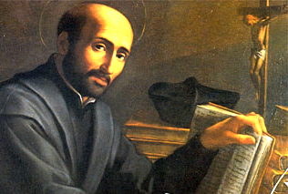
boundaries are important
Importance of Boundaries
Different types of boundaries: geographical boundaries & personal
Assertiveness - self-assured confidence that often results in bold action
Virtue
Foresight - Learn how to gather information in order to make the right decision for the long term
Saint
St. Ignatius of Loyola

Slide 5
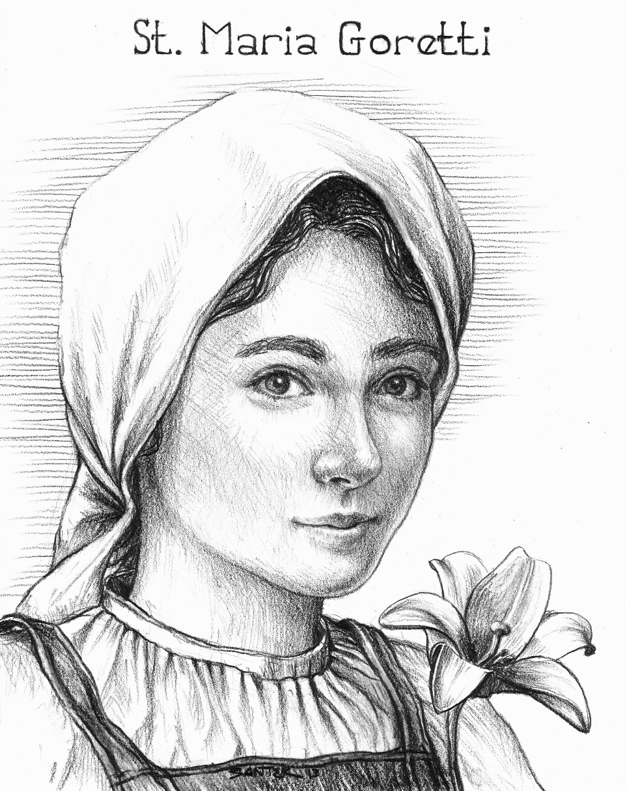
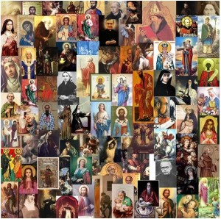
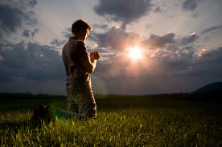
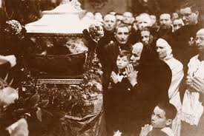
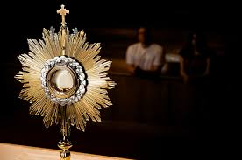
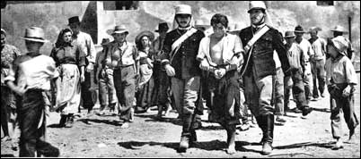
Our Body & Our Spirit were created good
Saint
St. Maria Goretti
Virtue
Purity - reflection of eternal beauty; living as God lives; unsoiled
Created to know, love, and serve God
Not everyone chooses to do so - Alessandro
Physical, Mental, Emotional, and Spiritual Health is a gift from God
Distortion
People use other people and harm the other’s physical, mental, emotional, and spiritual health
Made with Dignity : Respected and Cherished
How do we become like saints and avoid using ourselves for purposes that God did not intend?

Slide 6
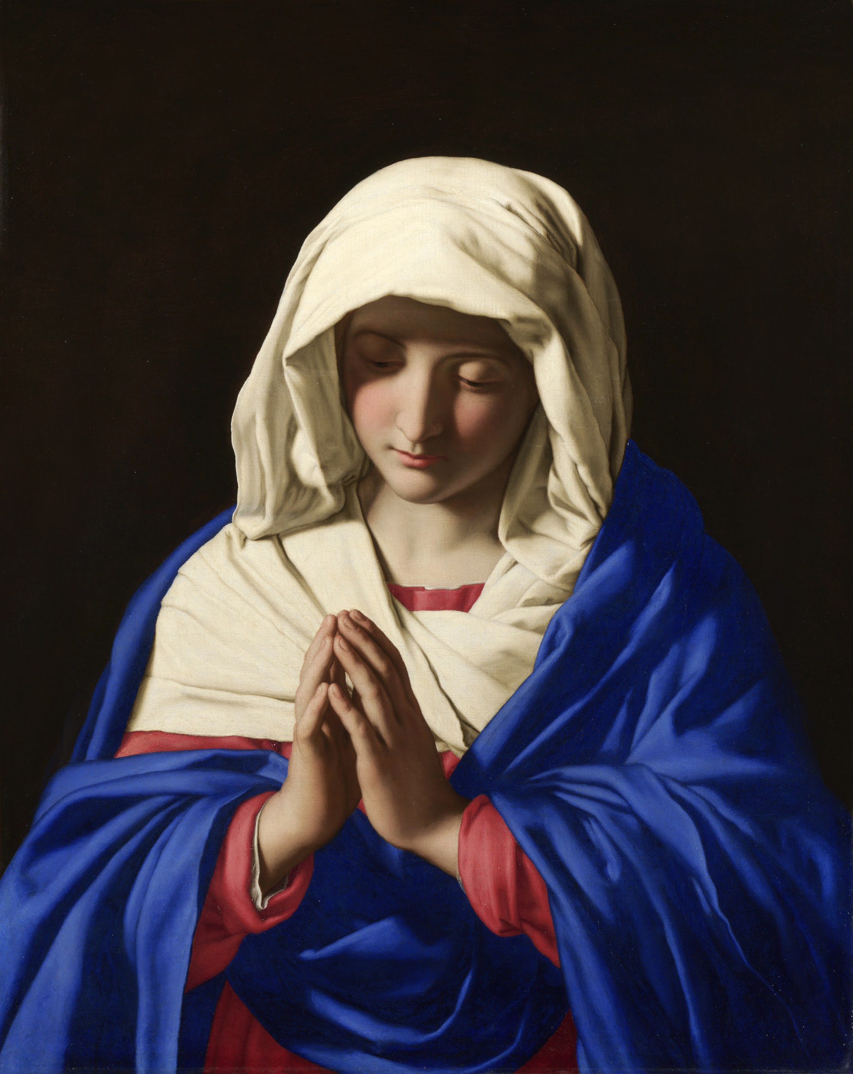
So what did we talk about???
Boundaries are important
Recognize that we are the Body of Christ
Our Body & Our Spirit were created good

Slide 7
Back in your Classroom...

Slide 8
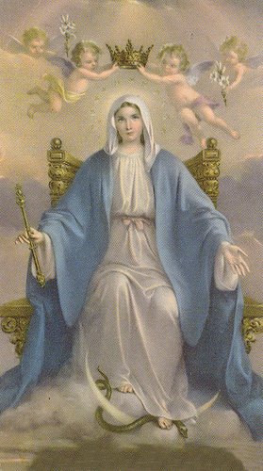
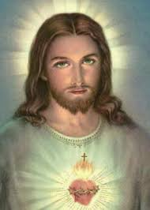
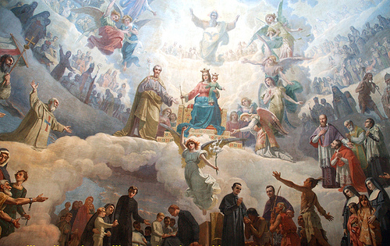
Saint Michael the Archangel
Closing Prayer
St. Michael the Archangel,
defend us in battle.
Be our defense against the
wickedness and snares of the Devil.
May God rebuke him, we humbly pray, and do thou,
O Prince of the heavenly hosts,
by the power of God,
thrust into hell Satan,
and all the evil spirits,
who prowl about the world
seeking the ruin of souls. Amen

Slide 9
