Slide 1
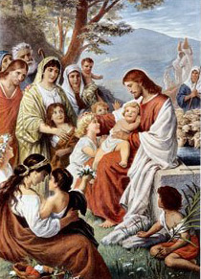
Safe Environment
Grades 1-3
March 2016

Slide 2
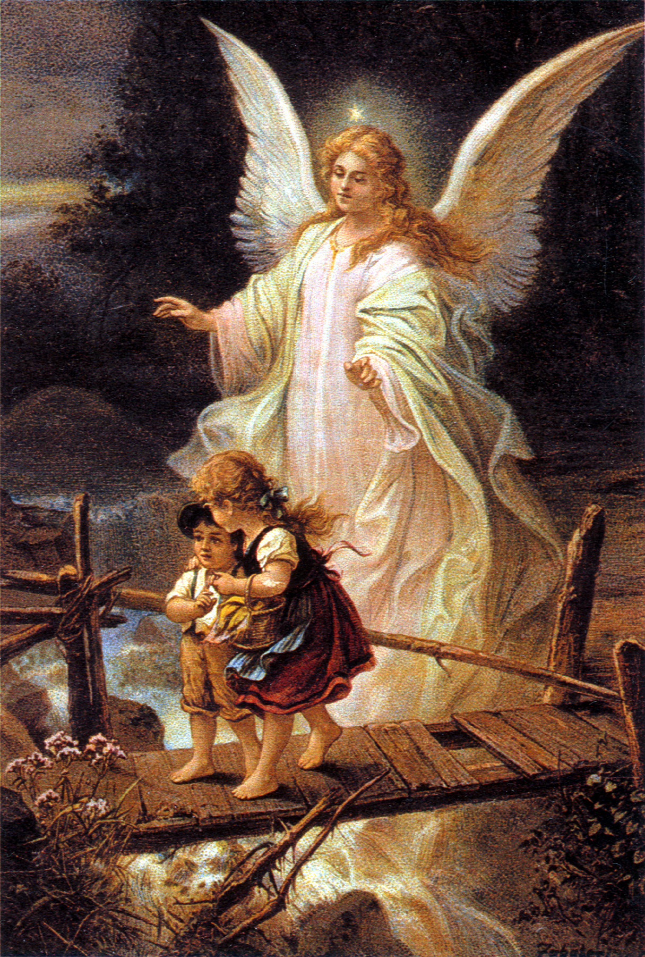
Angel of God
Opening Prayer
Angel of God
my Guardian dear
to whom His love
commits me here
ever this day
be at my side,
to light and guard,
to rule and guide. Amen.

Slide 3
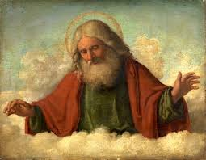
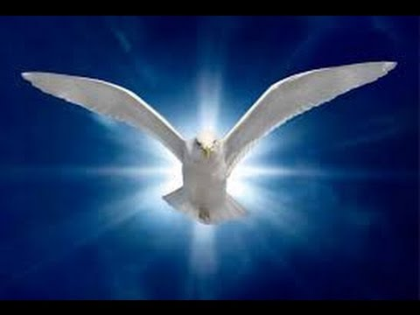
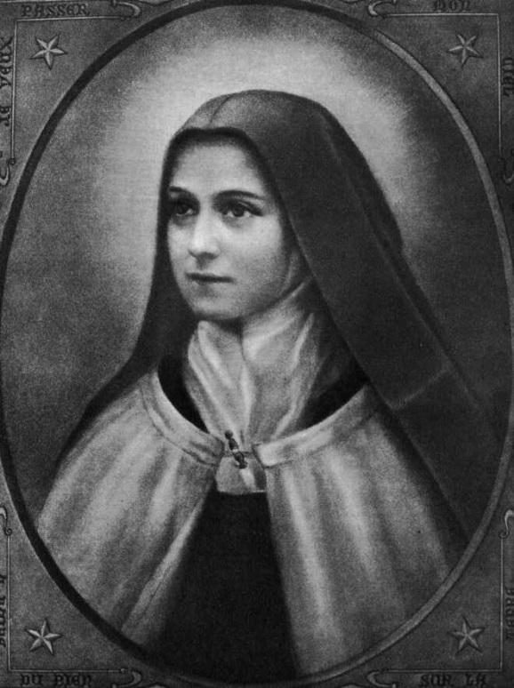
Parts of our bodies are considered private
Holy Spirit
Bodies as a Temple
Private Areas - Swimsuit Areas
Safe Touch and Unsafe Touch
Virtue
Good Counsel: asking someone for advice
Saint
St. Therese of Lisieux
Notes:
Main Objective:
To reinforce the parent’s teaching in knowing which parts of our bodies are considered private (R.7.1.E.4)
Describe the difference between safe and unsafe touch (R.7.1.E.4)
Teaching:
Play “My Body is a Temple of the Holy Spirit” Song from the Donut Man (http://www.donutman.com/?page=cds&album_id=3452785)
Ask to the class: Who made us? _________ Students raise their hand. Call on one. (Correct answer is GOD)
Ask again to the class: Who made us?________ Students raise their hand. Call on one. (Correct answer is GOD)
“Ok everyone, when I ask it again, I want EVERYONE to shout the answer as loud as you can all together! Ready? Who made us? (Everyone shouts GOD!)
Say: Because God is our Father (emphasize this word)….(pause)...What is God? Students raise their hand. Call on one. (Correct answer: FATHER)
Say: Because God is our Father, we are his children!
Ask: Because God is our Father, we are his __________? Students raise their hand. Call on one. (Correct answer is CHILDREN)
Say: Everyone has a father. You might call him dad! You may be very close to your dad. Maybe you aren’t that close to your dad. But, each of us has a father.
Say: God wants to take care of us and love us. He wants to live right inside of you (point to your own heart and have each of the students to the same on their own bodies)!
Say: He made your body special so that he can live inside of you.
Take Out the Paper Doll (Worksheet 1). Have them color themselves and include the Holy Spirit inside of them. The dove represents the Holy Spirit. Explain to them just like a temple is a place where God dwells, so too our bodies are places where God wants to live.
Say: God made your head (point to the head and have them point to their own heads), arms (point to the arms and have them point to their own arms), legs (point to the legs and have them point to their own legs), and many other areas of your body so that he can live in you!
Have the students stand. Play “My Body is a Temple of the Holy Spirit” Song from the Donut Man Again (http://www.donutman.com/?page=cds&album_id=3452785)
Have the students sit.
Say: There are certain areas of our bodies we don’t show other people. Some areas of your body are to remain private because that’s how God wanted it! That is the areas we cover up with our swimsuit. These are the areas that only we see and we keep private. God wants to keep us safe and holy!
Say: Remember our bodies are temples of the ________ ________ Students raise their hand. Call on one. (Correct answer is HOLY SPIRIT)
Say: Remember that anything that our swimsuits cover is private - it’s only for you and God. Sometimes, a doctor might have to give you a check up and that is ok if your mom or dad is in the room with you.
Say: Thank God every day for your body.
Objectives NOT Used:
Identify ourselves as children of God (R.7.1.E.1)
Vocabulary
Vocabulary: God, Father, Children, Private Areas (General Introduction: Temple, Holy Spirit)

Slide 4
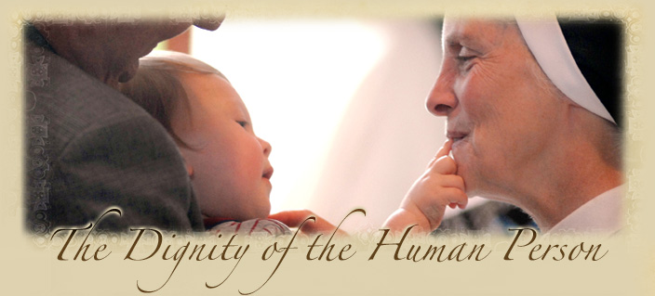
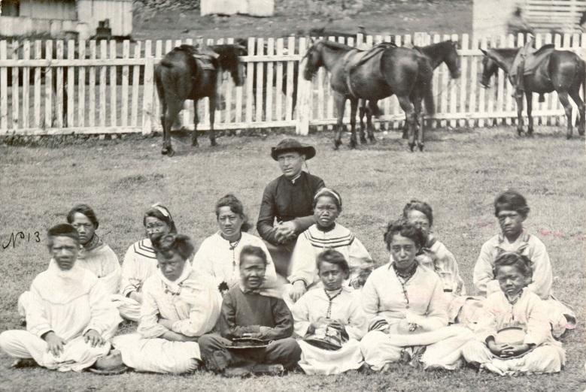
Respect others and their worth
Dignity of Every Life
Love and care for ALL God’s children
Babies to the Elderly
Virtue
Respect: speaking and acting according to your own dignity and the dignity of others
Saint
St. Damien of Molokai
Notes:
Main Objective :
Understand that all children are persons of worth and worthy of respect. (R.7.1.E.1)
Teaching
Ask: Who created you? Students raise their hand. Call on one. (Correct Answer: God)
Say: God created you to KNOW Him (point to your brain), LOVE Him (place your hand on your heart), and SERVE Him (wiggle your hands).
Say: Repeat after me - “God created you to KNOW (Students say KNOW), LOVE (Students say LOVE), and SERVE (Students say SERVE) Him.
Ask: God created you do three things. What are they? Students raise their hand. Call on one. (Correct Answer: know, love, and serve him)
Say: Because God made us, he wants us to love other people he created as well. We are called to respect another person. Respect is speaking and acting according to your own dignity and the dignity of others
Ask: How do you respect your mom? Students raise their hand. Call on one. (Answers may vary, but some examples might be following instructions, saying “yes mom”, listening when your mom talks to you, doing something nice for your mom)
Ask for a volunteer from the class to stand in the front of the room.
Ask: How do we show _________ (insert student’s name) respect? (Answers may vary, but some examples might be allowing him to go first, picking up his pencil if he drops it, smiling at him, saying hello to him in the morning, saying nice things to him, holding a door open for him)
Say: Everyone deserves respect because God made them!
Say: When you play with friends, be kind and respectful. Use Worksheet 3 to differentiate between good and bad play.
Ask: How do you know when someone is a good friend? (Answers may vary but some examples might be they are kind to you, they want to help you, they have something in common with you).
Say: Sometimes, there are people who might think they are our friend, but they are not.
Ask: What should a friend never do? (Answers may vary, but some examples might be that they will never take something from you, they will not be selfish, they don’t want you to do everything for them, they don’t make you do something that will get you in trouble, they don’t make you do something that makes you feel unsafe)
Ask: Have students give a thumbs up if they feel safe in the following situations:
Crossing the road with your parent’s permission after looking for cars (SAFE)
Someone you don’t know comes into your home. (NOT SAFE)
You and your little sister walk to the bathroom together (SAFE)
You go into someone’s car you don’t know (NOT SAFE)
Remember: God made us to do three things.
Ask: Does anyone remember those three things? (if the students don’t respond, touch your head, heart, and wiggle your hands) Students raise their hand. Call on one. (Correct Answer: Know, Love, and Serve God)
Objectives not used:
Differentiate between good and bad play. (R.7.1.E.2)
Describe experiences that make you feel safe or unsafe. (R.7.1.E.4
Know the difference between a true friendship and a false friendship. (R.7.1.E.3)
Vocabulary: Respect, Good friend

Slide 5
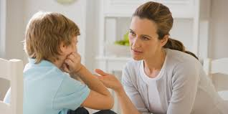
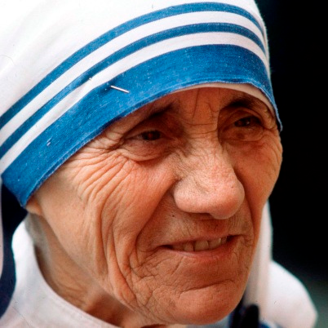
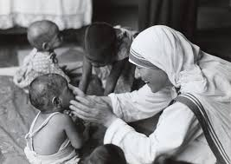
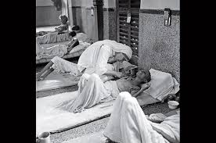
Say NO and Tell a Trusted Adult
Uncomfortable Situations
People who don’t respect us or put us in bad situations can make us feel uncomfortable
Say NO and Tell a Trusted Adult
Virtue
Good judgment: thinking rightly about a decision
Saint
Blessed/Saint Mother Teresa of Calcutta (Canonized in 2016)
Notes:
Main Objective:
Say “no” with confidence. (R.7.1.E.2)
Recognize that it is the best thing to tell a trusted adult when you are uncomfortable or feel unsafe. (R.7.1.E.4)
Teaching
Ask: Who made you? (review question) Students raise their hand. Call on one. (Correct Answer: God)
Ask: Why did God make you? (review question) Students raise their hand. Call on one. (Correct Answer: To know, love, and serve him)
Say: God created you beautiful and good. He created you out of love. God loves us and so should other people. Other people are called to respect you.
Ask: How do others respect you? Students raise their hand. Call on one. (Answers may vary, but some examples might include doing nice things for you, smiling, helping you when we need help, helping you come closer to God, listening to you)
Say: Jesus loves you so much regardless of the good or bad things you do.
Say: Sometimes, people don’t respect us the way Jesus respects us. Sometimes, people can be mean or they do things that make us feel uncomfortable. If you are ever in a situation that makes you feel unsafe, what should you do? Students raise their hand. Call on one. (Correct Answer: Say “no” and go to a trusted adult)
Say: If anyone ever makes you feel uncomfortable or unsafe, you just say “no” and walk away to a trusted adult and tell them what happened.
Hand each student a piece of paper and have them trace their hand. Say: When something unsafe happens, you are to go to a trusted adult. List one trusted adult on each of your fingers. You should have five people total that you are comfortable going to and talking with. (Examples could include: Dad/Mom, teacher, Grandpa/Grandma, a friend’s parent, coach, etc)
Ask: Why do you feel safe with these five people? Students raise their hand. Call on one. (Answers may vary, but some examples might be that they look out for their good, they love Jesus, they make good decisions, they are present and help me when I need help, they pray with me, etc).
Go through a few examples of situations where you would say “no” and tell a trusted adult:
If someone is following you
If someone is trying to get you to go with them
If someone you don’t know is trying to give you a ride
If someone you don’t know is knocking at the door
If you see something bad on the computer
Say: There are different kinds of friends. Use worksheet 5 to identify different types of friends.
After the students have had the ability to draw their friends, ask why one of their friends they drew is a friend (Answers may be because they are kind, help me, make me laugh, bring me closer to Jesus, etc)
Say: Friends are important to bring you closer to Jesus and keep you safe.
Vocabulary: Good judgment, trusted adults, friends
Objectives NOT Used
Say “no” with confidence. (R.7.1.E.2)
Recognize that it is the best thing to tell a trusted adult when you are uncomfortable or feel unsafe. (R.7.1.E.4)

Slide 6
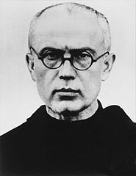
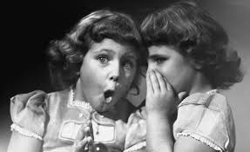
Words and Actions should bring us closer to Jesus
Be Truthful and Kind
Secrets can pull us away from God and others
Be Kind and Sincere to friends
Abuse - Misusing a person for a bad reason
Virtue
Sincerity: having a genuine care for others, “trustfulness” in words and action
Saint
St. Maximilian Kolbe
Notes:
Teaching:
Say: The way we speak to others is very important. Let’s look at the story of Mary meeting Elizabeth This is called the Visitation. Those two cousins met when Elizabeth was pregnant with….(John) and Mary was pregnant with…(Jesus). Their words are forever remembered by us because it is so important.
Read the words of Elizabeth in Luke 1:39-45.
Ask: The words of Elizabeth are in the words of what prayer? Students raise their hand. Call on one. (Answer: Hail Mary)
Say: Words matter and can bring us closer to Jesus or farther from him. We need to be truthful and always be kind toward other people. Secrets can separate you from others if it hurts them or makes them feel left out.
Ask: If someone tells you a secret and not to tell anyone, who do you talk with? Students raise their hands, call on one. Answer: Your trusted adults (based on the 2nd grade lesson, students listed 5 trusted adults who are best to talk with when a situation arises that could jeopardize safety).
Say: There are many types of friends who we speak to, but we must remember to be kind and sincere when we are with them.
Ask: What does sincere mean? Students raise their hand. Call on one. (Answer: having a genuine care for others, trustfulness in words and action)
Say: Certain people in our lives may seem like friends, but are not friends. These are the people who try to take something from us, make us feel uncomfortable, or draw us farther away from Jesus.
Say: We have to be aware of people using us for something that God hasn’t designed. This is called abuse (abuse defined = misusing a person for a bad effect)
Use worksheet 6 to talk about how things can be properly used/loved and misused/mistreated. Catechist/Teacher Note: Remember that things are meant to be USED. People are meant to be LOVED. We are simply using this example noting that all things/people have a proper purpose to them.
NOTES:
Purpose of a bike is to ride. Misuse of a bike is running into children on the sidewalk or stopping traffic in the middle of the road.
Purpose of a chair is for sitting. Misuse of a chair is throwing it at another person.
Purpose of an apple is to be eaten. Misuse of an apple is tossing it at cars or throwing it at another person.
Purpose of a person is to know, love, and serve God. Abuse of a person is when someone doesn’t allow a person to realize this potential. Someone who abuses a person is not looking out for how that person can love God better, but simply wants to use them.
Say: People are meant to be loved, not used as objects. People should always treat others with love, not violence or hurt. When people misuse another person - or use them instead of loving them, that is called abuse.
Say: If at any time someone is being abused, you tell a trusted adult immediately.
Say: We always pray for those who haven’t been loved as Jesus intends them to be.
Vocabulary: Visitation
Objectives
Recognize secrets can separate you from others. (R.7.1.U.2)
Define different kinds of friendships (R.7.1.U.3)
Define abuse (R.7.1.U.4)

Slide 7
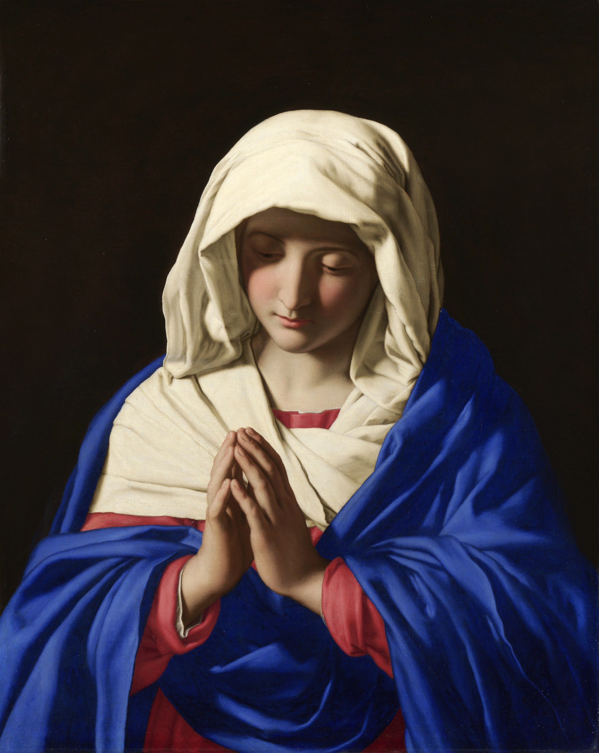
So what did we talk about???
Parts of our bodies are considered private
Respect others and their worth
Words and Actions should bring us closer to Jesus
Say NO and Tell a Trusted Adult

Slide 8
Back in your Classroom...

Slide 9
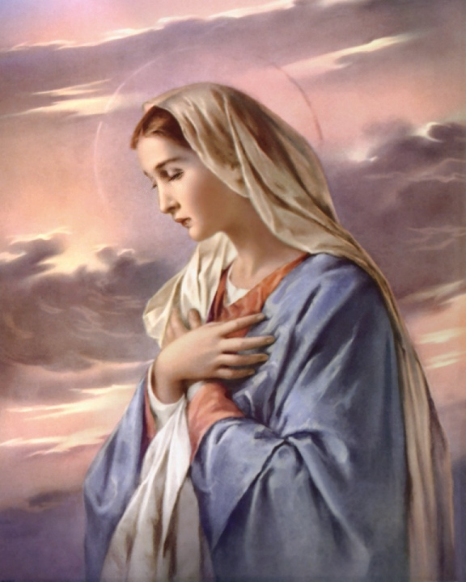
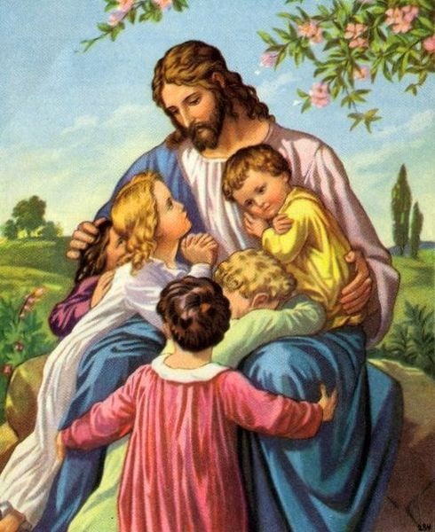
Angel of God
Closing Prayer
Angel of God
my Guardian dear
to whom His love
commits me here
ever this day
be at my side,
to light and guard,
to rule and guide. Amen.

