Slide 1
Faith Formation Kick Off
September 2014

Slide 2
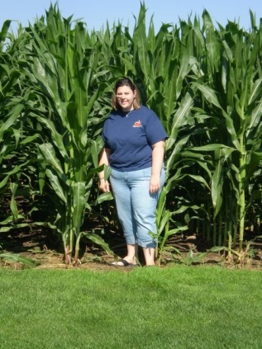
Introductions
Stephanie Rottier
Faith Formation Coordinator
Youth Minister
Youth Ministry Events Coming Up
FNL’s - Packets available in classrooms
Bowling Night in the Future
Service Day – October 25, 2014

Slide 3
Friday Night Lives
Friday Night Lives are mostly FREE nights of Faith, Fun, and Food with other Middle School Students on the West Side of Green Bay.
Event location changes each month, as well as event theme, food, and activity.
Our next FNL is at the Quad Parishes – St. Joseph Site – and the theme is Glow in the Dark!
Contact Stephanie if you have more questions about this fun idea!!

Slide 4
Introductions
Stephanie Rottier
Faith Formation Coordinator
Youth Minister
Youth Ministry Events Coming Up
Connect 4’s
Made 4 More Conference
Youth Group After Religion on Wed.
Service Day – October 25, 2014

Slide 5
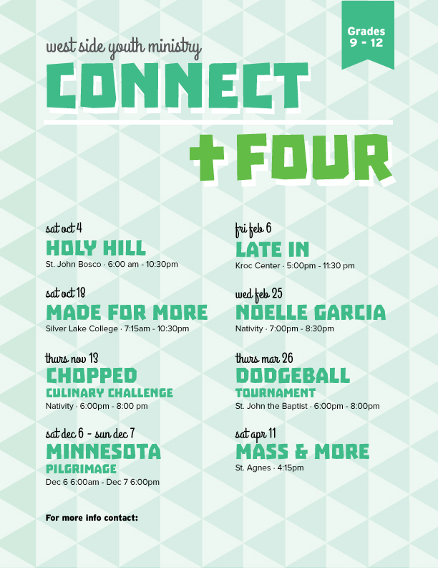
Connect 4’s
Connect 4’s are mostly FREE nights of Faith, Fun, and Food with other High School Students on the West Side of Green Bay.
Event location changes each month, as well as event theme, food, and activity.
Our next Connect 4 is here at Nativity and the theme is Chopped – Culinary Challenge!
Contact Stephanie if you have more questions about this fun idea!!

Slide 6
Kahoot Fun!
Okay everyone…take out your devices if you brought them along and log on to…
www.kahoot.it
Then, look up at the screen and log in with the game pin up there. Don’t forget to add your name or appropriate nickname to play the game. ☺

Slide 7
Jesus pAID The ULTIMATE PRICE!

Slide 8
Let’s Play

Slide 9
What is the actual retail price without going over?

Slide 10
Let’s Play a Game Where yoU could Win…

Slide 11
…THIS!!!

Slide 12
PUSH THE BLOCKS!!
Rules:
Stephanie will read you a summary of a time period in Catholic History. When she finishes, you will push the blocks over the edge of the table until the four blocks that make up the year number are represented under the construction paper. You may push the blocks forward, but you are not allowed to push the blocks backwards.
GOOD LUCK!!

Slide 13
Who’s Our Next Contestant?
_________ come on down! You are the next contestant on the Price is Right!

Slide 14
What is the actual retail price without going over?

Slide 15
Let’s Play a Game Where yoU could Win…

Slide 16
…THIS!!!

Slide 17
Let’s Play…

Slide 18
Plinko
Here you will be given 5 scenarios. With each scenario you will be given two choices on how best to react. If the choice is right, you will receive an additional Plinko chip. I will start you with one chip, but you must earn the rest. ☺

Slide 19
Let’s Spin the Wheel!

Slide 20
Who’s Our Next Contestant?
_________ come on down! You are the next contestant on the Price is Right!

Slide 21
What is the actual retail price without going over?

Slide 22
Let’s Play a Game Where yoU could Win…

Slide 23
…THIS!!!

Slide 24
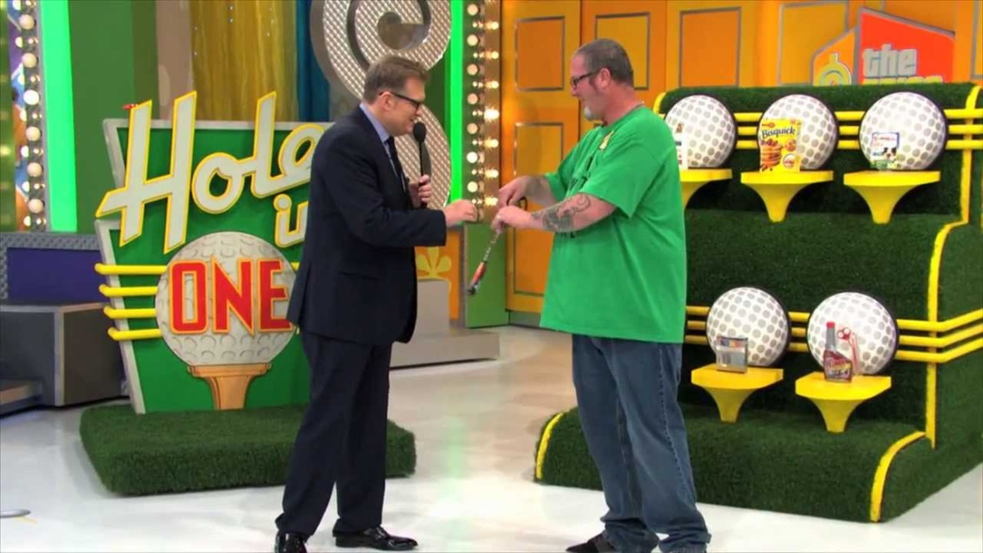
Hole In One
Here you will be given 5 events in Catholic History. You need to put the events in chronological order. Based on your correct answers, is where you will be putting from.

Slide 25
Who’s Our Next Contestant?
_________ come on down! You are the next contestant on the Price is Right!

Slide 26
What is the actual retail price without going over?

Slide 27
Let’s Play a Game Where yoU could Win…

Slide 28
…THIS!!!

Slide 29
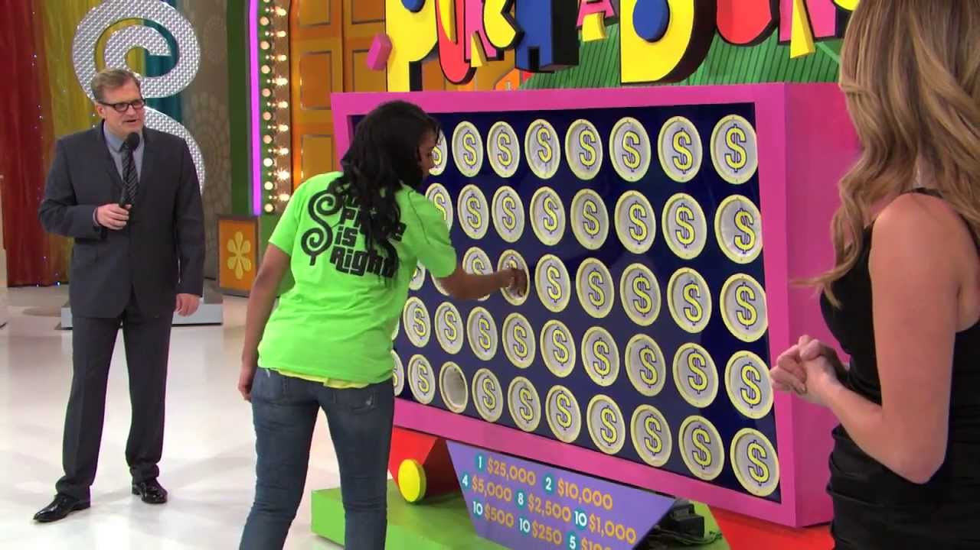
Punch the Holes
Here you will be given 4 different questions to answer. With each correct answer you get a “punch.” After punching the # of correct answers, one at a time we will go through and pull out what you have one. At each pull, you will have a choice of keeping your prize or leaving it and going to the next one. Good luck!!

Slide 30
Let’s Spin the Wheel!

Slide 31
It’s the…

Slide 32
First Showcase

Slide 33
First Showcase Includes…

Slide 34
First Showcase Includes…

Slide 35
First Showcase Includes…

Slide 36
First Showcase Includes…

Slide 37
Pass or Play?
What do you bid?

Slide 38
Second Showcase

Slide 39
Second Showcase Includes…

Slide 40
Second Showcase Includes…

Slide 41
Second Showcase Includes…

Slide 42
Second Showcase Includes…

Slide 43
What do you bid?

Slide 44
The Actual Retail Price Is…

Slide 45
Winner

Slide 46
Thanks for Playing
Thanks for playing…you may head back to class!!

