Slide 1
ACRE
Assessment of Children/Youth Religious Education

Slide 2
We get to spend the next hour discussing data!

Slide 3
What is the ACRE
Originally created by NCEA with University of Kansas and Boston College
Assessment of Catholic Religious Education (1970’s)
Assessment of Catechesis/Religious Education (August, 2001)
Revised 2013 with Computerized Assessments and Learning (CA&L)
Field tested, piloted, scrutinized by national and diocesan catechetical leaders, theologians and catechists.

Slide 4
NCEA’s Vision
Tool for assessing program effectiveness
Offer a picture of where students should be in terms of basic religion knowledge
Grade 5 – level 1
Grade 8-9 – level 2
Grade 11-12 – level 3
Assess beliefs, attitudes, practices, and perceptions
Provide information on areas of strength, and those in need of improvement

Slide 5
Why use the ACRE?
Accountability
It does not measure everything.
It does measure something – important.
Because what we teach matters!
Because all Christian religions are not “basically the same.”
Speak the truth with great love.

Slide 7
Ephesians 4:12-15
“…to equip the holy ones for the work of ministry…so that we may no longer be infants, tossed by waves and swept along by every wind of teaching arising from human trickery [and] deceitful scheming. Rather, living the truth in love, we should grow in every way into him who is the head, Christ…

Slide 8
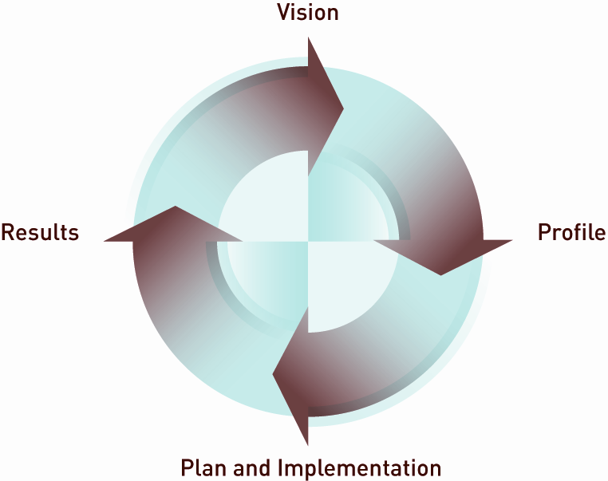
Continuous Improvement

Slide 9
Why use the ACRE?
Continuous Improvement
Plan
Do
Check
Act
Repeat

Slide 10
Why use the ACRE
Because…
Good is the enemy of GREAT!
Good enough isn’t!
As long as you’re green you grow. As soon as you think you’re ripe, you begin to get rotten!

Slide 11
Why use the ACRE?
And on top of all of these very good reasons:
Our Bishop said so!

Slide 12
Use it well!
Evaluate the effectiveness of a religion program:
Curriculum
Materials
Teaching/Learning
Formative experiences in faith community.
Not the only evaluation tool – but a good one.
Don’t let others misuse it!
Treat it as a “standardized test”.

Slide 13
Use it well! Three phases ---
Preparation
Engage catechists/faculty – Curriculum Alignment Review Process
Purpose – improve student performance
Assessment
One 75 minute or two 45 minute sessions
Follow the directions
Post assessment
Study results
Engage Continuous Program Improvement

Slide 14
Design of the Assessment
http://www.ncea.caltesting.org
Two programs
NCEA Assessment of Children/Youth Religious Education (Levels 1, 2 and 3)
Information for Growth (Adults)

Slide 15
Assessment of Children/Youth Religious Education
Three levels (Diocese of Green Bay)
Grade 5 – Level 1
Grade 8 – Level 2
At the end of classes before Confirmation – Level 3
Two Parts
faith knowledge (cognitive domain)
beliefs, behaviors, attitudes, and practices (affective domain) (self reported)

Slide 16
Sample Question
Faith Knowledge -- Selected Response
Our vocational call as lay persons, ordained ministers, or vowed religious is rooted in which sacrament?
Matrimony
Eucharist
Penance
Baptism
(Level 3)

Slide 17
Sample Question
Affective Domain --Likert Scale – forced choice
Strongly agree
Agree
Disagree
Strongly Disagree
Even when I sin, God still loves me.
(Levels 2 and 3)

Slide 18
Sample Question
Please read each statement and then decide to what extent it is a problem at your school.
Mark: A) not a problem
B) a minor problem
C) a big problem
Teasing, bullying, name-calling
(Levels 2 and 3)

Slide 19
Six Domains (Six Tasks of Catechesis from General Directory and National Directory)
Knowledge of Faith
Liturgical Life
Moral Formation
Prayer
Communal Life
Missionary Spirit
(Align with the protocols established by USCCB for reviewing religion textbook series.)

Slide 20
Faith Knowledge: Four Pillars of the Catechism of the Catholic Church
Profession of Faith (Creed)
The Celebration of the Christian Mystery (Liturgy and Sacraments)
Life in Christ (Morality)
Christian Prayer

Slide 21
Beliefs, Behaviors, Attitudes, and Practices
Relationship with Jesus Christ
Images of God
Catholic Identity
Morality
Relationships with others
Perceptions about your school or parish program
Students’ concerns

Slide 22
How do we help our students take it seriously?
Take it seriously yourself! Use the results.
Help your catechists/teachers take it seriously by engaging them.
Talk to students about the assessment and how the results will be used.
Consider giving the assessment yourself.
Send a copy of the student results (individual compared to group) to the parents.

Slide 23
Standardized Assessment
Garbage in – garbage out!
Assessment Instructions for the assessment coordinator.
Administration Manual for those giving the assessment.
Easy to follow – but preparation is needed. Read through all directions ahead of time and have your teachers/catechists do the same.

Slide 24
Helping students with special needs?
Readers
Special lighting
A quiet location
Frequent breaks
Visual magnification
Use of a scribe to mark responses
Signing of directions
Additional time

Slide 25
Test Results – Cognitive Domain
All, Catholic, Non-Catholic, Returning
Faith knowledge by domains
Total Scores, Standards Classification and Domain Summary
Summary Scores by the Four Pillars of The Catechism of the Catholic Church
Faith Knowledge Score Frequency Distribution

Slide 26
Teaching and Testing
Teaching the test – the mortal sin of assessment.
Teaching to the test
aware of the NCEA ACRE content specifications.
Using them as benchmarks – elementary, middle, high school
Not teaching specific test questions

Slide 27
Teaching and Testing
Cohort Data
Follow a class over the years
longitudinal data
Measure of growth
Fixed Point Data
Compares groups of students as they pass a given point in subsequent years
Provides program data

Slide 28
Using the Results
Curriculum Alignment Worksheet
Appendix C of Interpretation Guide
Involve catechists/teachers
Strengths, Weaknesses, Recommendations

Slide 29
Affective Statement Summaries
5 words that would describe the spiritual characteristics of Catholic middle school students
What % of Catholic middle school students regularly attend Saturday Evening/Sunday Mass?
Besides religion class, where do you think Catholic middle school students talk about faith?
How many Catholic middle school students are open to exploring a religious vocation?

Slide 30
Catholic Identity and Religious Programming
Personal relationship with Jesus
Openness to prayer
Being Catholic is important
Strong sense of morality
Value and think positively about Catholic institutions
(Based on preferred responses to affective statements that were over 90%. There were 25 such items out of 41.

Slide 31
Catholic Identity
What % of Catholic middle school students attend Sunday Mass regularly? 82% (increase)
Besides school, where do you think Catholic middle school students talk about faith? Friends 69%, Parents 78% (increase)
How many Catholic middle school students are open to exploring a religious vocation? 31% (increase)

Slide 32
Data Discovery Day
Bring your team
Bring your data
Hands on – interactive
Results oriented

Slide 33
First Pass
Overview for your team
Overview of your results
Study: Total Score, Standards Classification and Domain Summary
Study: Score Summary by the Four Pillars
Identify strengths
Identify areas for improvement

Slide 34
Second Pass
Study: Affective Statement Summaries and Student Concerns
Dig into: Identified Domains with Faith knowledge Items by Domain
Analyze: Score Frequency Distributions
Identify additional strengths, areas for improvement and possible improvement strategies

Slide 35
Program Improvement Plan
Introduction to “Continuous Improvement”
Establish SMART Goals
Improvement Plan Format
Improvement Planning
(You will leave with the beginnings of a Program Improvement Plan.)

Slide 37
Xavier Average compared to National Average 2009-2011

Slide 38
OK, so now you are really tired!

Slide 39
Top Ten Things to Say when Caught Sleeping at your Desk
They told me at the Blood Bank this might happen.
This is just a 15-minute power nap they raved about in the time management course you sent me to!
Whew! Guess I left the top off the Whiteout. You got here just in time!
I wasn’t sleeping! I was meditation on the Diocesan Vision and Mission statement.
I was testing my keyboard for drool resistance.

Slide 40
Top Ten Things to Say when Caught Sleeping at your Desk
I was meditating on cosmic significance of the latest curriculum modifications.
Darn! Why did you interrupt me? I had almost figured out how to raise that last 3 million for the Bishop’s Appeal.
Did you ever notice sound coming out of these keyboards when you put your ear down real close?
Who put decaf in the wrong pot?

Slide 41
…and the number one thing to say when caught napping at your desk
Raise your head slowly and say
…in Jesus name, Amen.

Slide 42
Faith Knowledge Items by Domain
With your colleagues:
Study the results
What observations or questions do they raise?
Strengths?
Areas for improvement?
Recommendations?
Don’t you just love data!

Slide 43
Total Score, Standards Classification and Domain Summary
With your colleagues:
Study the results
What observations or questions do they raise?
Strengths?
Areas for improvement?
Recommendations?
Don’t you love data even more!

Slide 44
Score Summary by the Four Pillars of the Catechism of the Catholic Church
Read and think
Share with one other person
Share one observation, question, strength, area for improvement, or recommendation with your group.
Data is
A four letter word!
The plural of datum
Just plain fun!
All of the above

Slide 45
Faith Knowledge Score Frequency Distribution
Examine this page individually.
Discuss
What does this data show?
How is this data useful?
Write a student improvement goal that might come from this data.
SMART Goal – Specific, Measurable, Attainable, Realistic, Timely
Give me a D…A…T…A

Slide 46
SMART Goal
Specific – Who,? What,? When,? Where? Which? Why?
Measurable – How many? How much? How will we know success?
Attainable – within our sphere of influence.
Realistic – objective toward which you are both willing and able to work.
Timely – grounded in a time frame.

Slide 47
Affective Statements by Student Information Category
Think – Pair – Share
What do you find encouraging?
What do you find troubling?
What program recommendation might come from this data?
Data quote

Slide 48
Affective Statements – Student Concerns
Discuss:
What surprises you about this data?
What confirms something you already suspect from your ministry?
How could your catechists/teachers use this data
Data quote

Slide 49
And just in case this is not enough data…Appendix B
Local programs can add up to 20 questions at no charge.
Level specific.
Only multiple choice questions.
Pool of questions at www.ncea.org, or write your own.
Must adhere to the answer key.
Administer in a “pre-assessment” session.

Slide 50
Pope Benedict XVI Speaking to Catholic school teachers:
To all of you I say: Bear witness to hope. Nourish your witness with prayer. Account for the hope that characterizes your lives by living the truth which you propose to your students. Help them to know and love the one you have encountered, whose truth and goodness you have experienced with joy.

