Slide 1
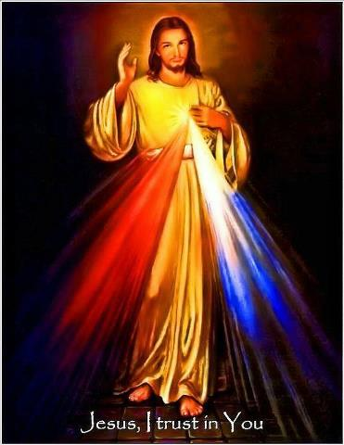
High School Curriculum Day
Diocese of Green Bay
+ All for God’s Greater Glory +

Slide 2
High School
They don’t care
They don’t talk
No one wants to be there
They don’t take it seriously
They are on their phones
They can’t concentrate
The catechist isn’t very engaging
No one goes to Sunday Mass anyway
They leave after Confirmation anyway
The family doesn’t support what we are doing
Is it even worth it?

Slide 3
Philosophies Shaping Youth Culture
Sentimentalism
Relativism
Progressivism
Utilitarianism
Consumerism
Gender Neutrality
Notes:
Sentamentalism: upbeat overemphasis on the inherent goodness of mankind that judges what is good or evil according to how well it accords with our feelings, or the feelings of people we want to impress
a sentimental Christian would rather their friend miss the opportunity for salvation rather than hurt his feelings
Relativism: Relativism is the assertion that truths (especially moral truths), have no validity independent of the “values” treasured by the person or society that asserts them; “That is your truth or the way you see the world”; No one can know anything for sure
Progressivism: Progressivism, or “chronological snobbery,” confuses “new” with “true.” It also confuses facts with values, by using a factual, chronological term to carry a value meaning.; something “modern,” “contemporary,” or “current” is “truer,” “better,” or “more reliable”; Anything that is past, ancient, or history is deemed “out-of-touch”
Utilitarianism: the ethical theory that pleasure is the greatest good, suffering the greatest evil.
Consumerism: the contemporary face of avarice, which drives individuals to define themselves and judge their value in terms of material acquisition and the social status that it confers
Gender Neutrality: The contemporary idea that gender identity does not exist; A person’s gender is merely a biological accident and can be changed to suit their chosen gender

Slide 4
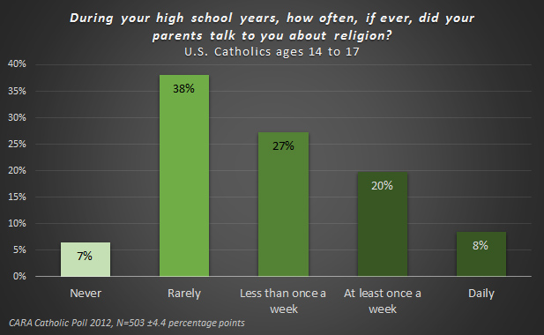

Slide 5
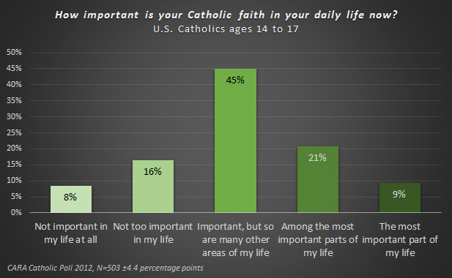

Slide 6
Who are They?
Need to be UNDERSTOOD
Need to BELONG
Need to be TRANSPARENT
Need to ENGAGE in CRITICAL THINKING
Need GUIDANCE

Slide 7
How do we keep kids in the Church?
We have to remind ourselves why we want them there in the first place.

Slide 8
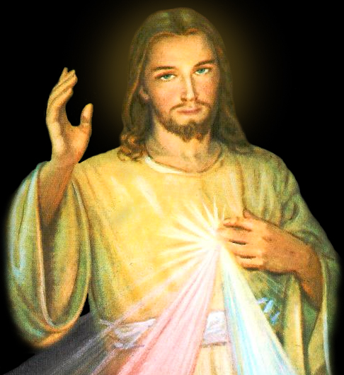

Slide 9
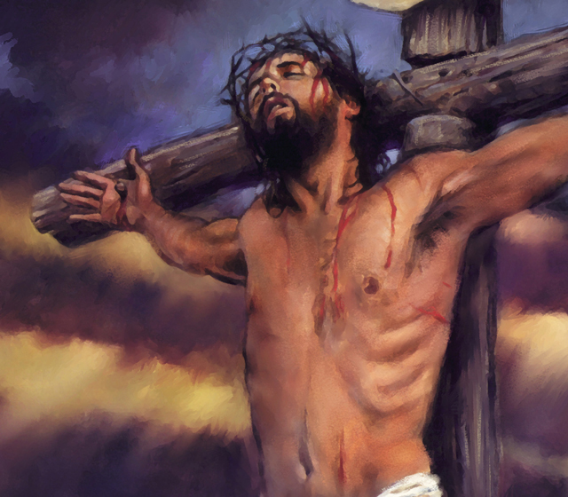
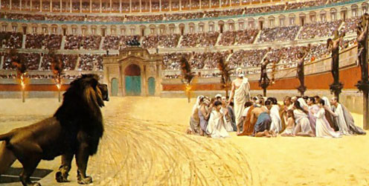
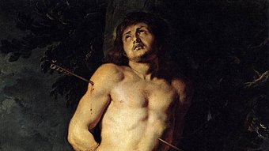
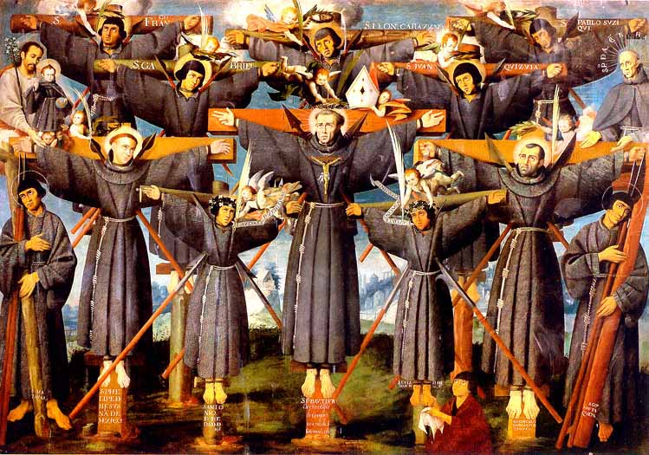
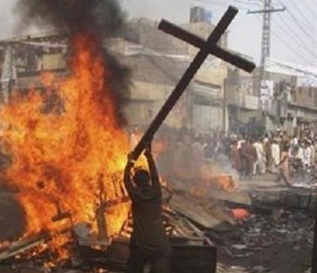

Slide 10
CATECHESI TRADENDAE “Catechesis in our Time”
“the aim of catechesis is to be the teaching and maturation stage, that is to say, the period in which the Christian, having accepted by faith the person of Jesus Christ as the one Lord and having given Him complete adherence by sincere conversion of heart, endeavors to know better this Jesus to whom he has entrusted himself: to know His "mystery"

Slide 11
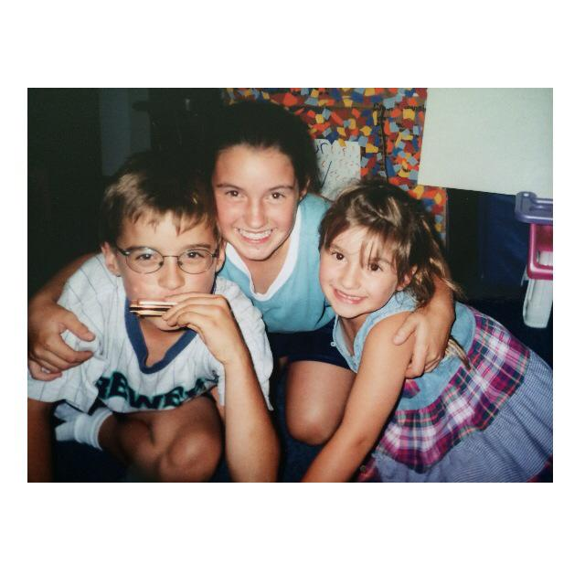

Slide 12
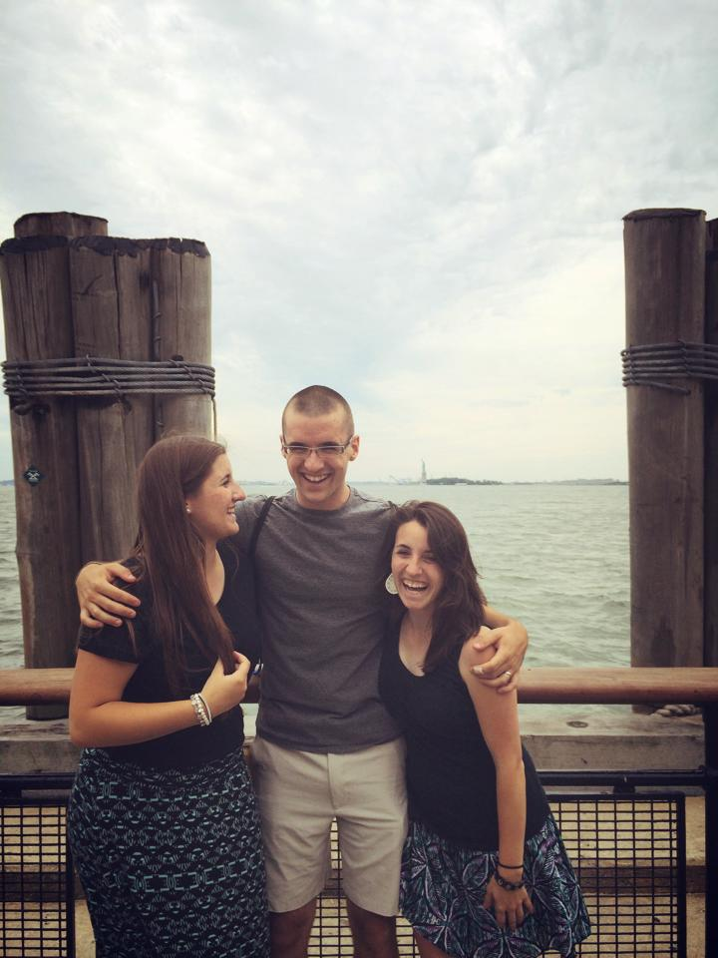

Slide 13
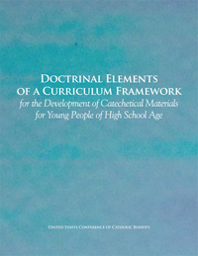
Framework
Six High School Semesters
Fall Freshman
Spring Freshman
Fall Sophomore
Spring Sophomore
Fall Junior
Spring Junior
Fall Senior
Spring Senior

Slide 14
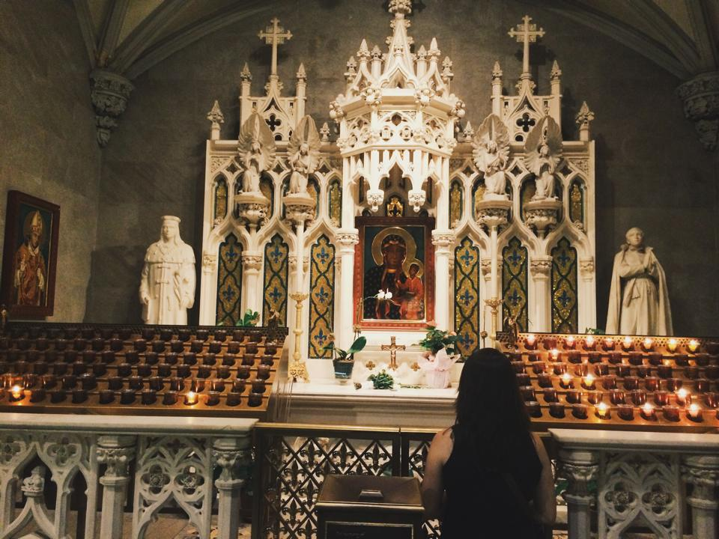
Framework
Written by the US Bishops in 2008
Purpose: put people in communion and intimacy with Jesus

Slide 15
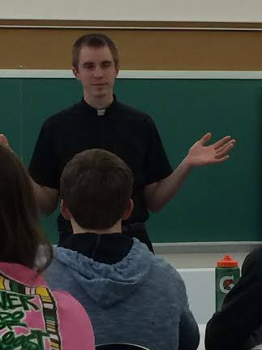
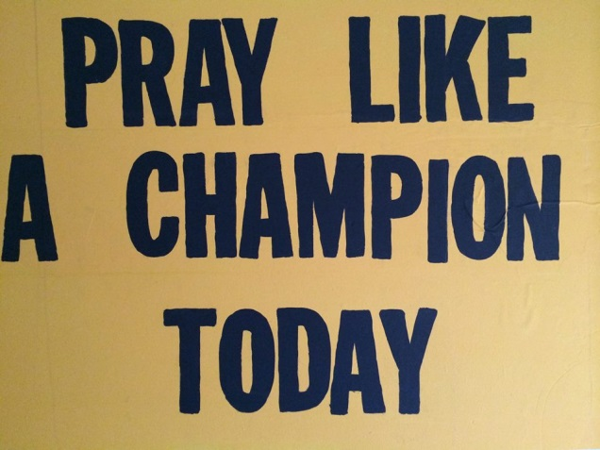
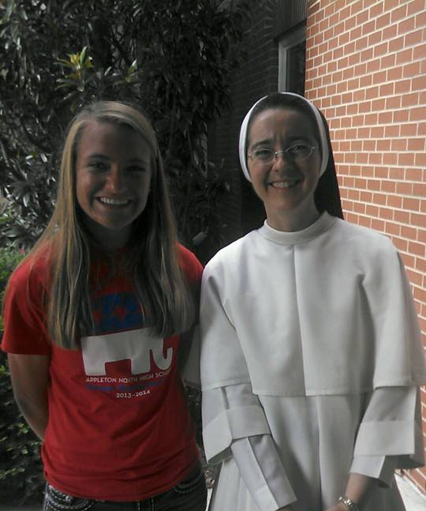
Framework
Intended for RE/YM for both are catechetical
Published as a guide to catechetical publishers
Recommended that the semesters be done in order
Topics aren’t completely developed
Places an emphasis on apologetics

Slide 16
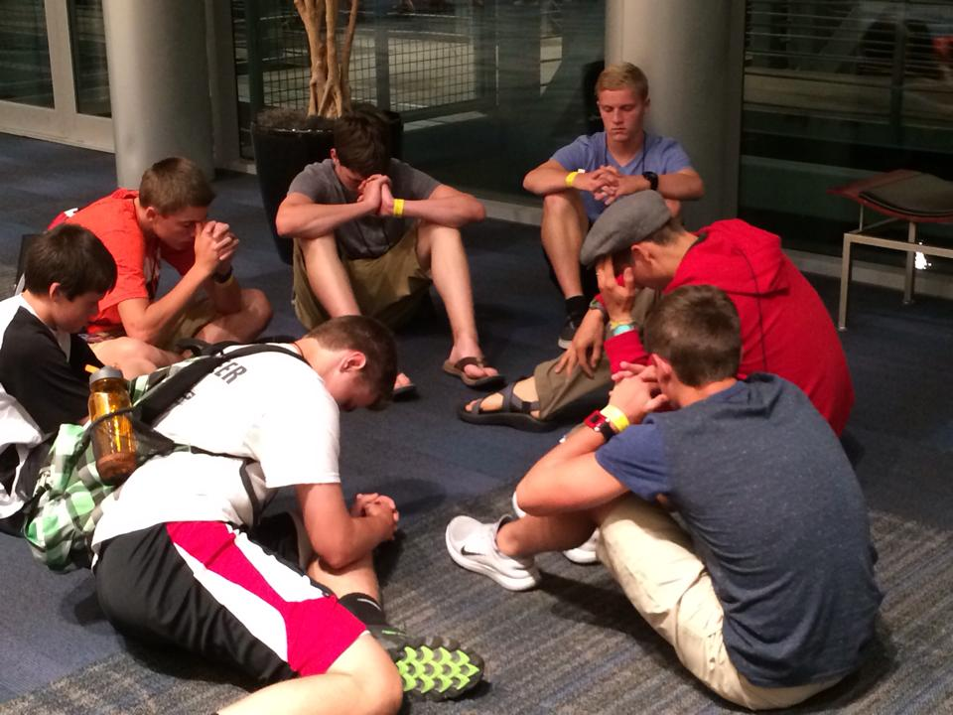
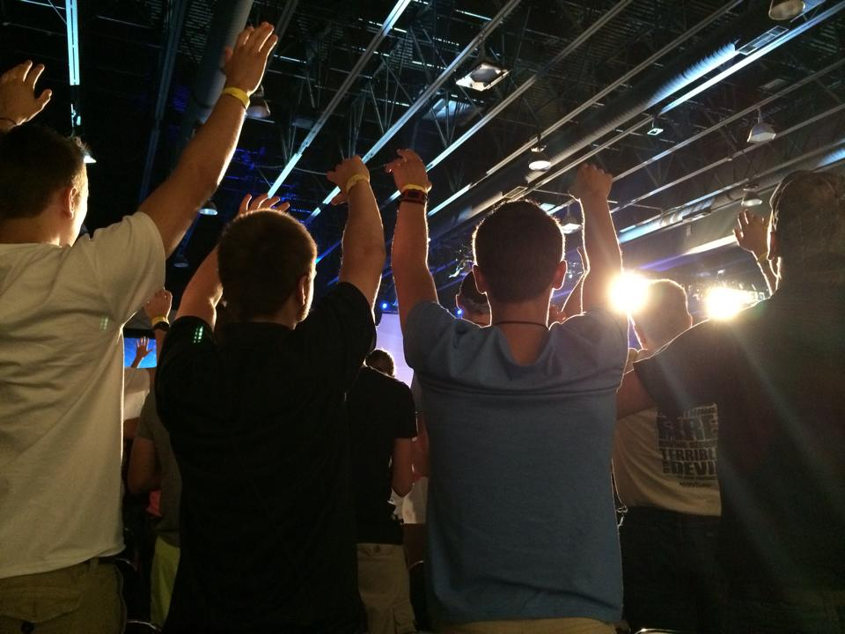
CATECHESI TRADENDAE “Catechesis in our Time”
“Very soon the name of catechesis was given to the whole of the efforts within the Church to make disciples, to help people to believe that Jesus is the Son of God, so that believing they might have life in His name,(3) and to educate and instruct them in this life and thus build up the Body of Christ. The Church has not ceased to devote her energy to this task.”
“At the heart of catechesis we find, in essence, a Person, the Person of Jesus of Nazareth”

Slide 17
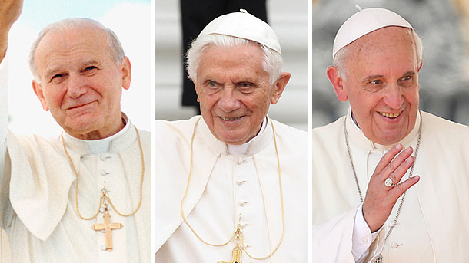
CATECHESI TRADENDAE “Catechesis in our Time”
We must therefore say that in catechesis it is Christ, the Incarnate Word and Son of God, who is taught - everything else is taught with reference to Him - and it is Christ alone who teaches
Only in deep communion with Him will catechists find light and strength for an authentic, desirable renewal of catechesis

Slide 18
High School Approved Textbooks
Green Bay Diocese
St. Mary Press
SCHOOL (Semester Series)
PARISH (one Book: Catholic Faith Handbook for Youth, 3rd Edition)
Our Sunday Visitor (Semester Series)
Didache Series by Midwest Theological Forum (Semester Series only)
Ave Maria Press (Semester Series only); General Editor is Michael Pennock

Slide 19
High School Curriculum (Framework of Bishops 2007)
Grade 9 | 1st Semester: 15-17 hours | 2nd Semester: 15-17 hrs | Total: 30-35 hrs/yr
Framework Title - > | The Revelation of Jesus Christ in Scripture | Who is Jesus Christ? | 1 year = 2 courses
Grade 10 | 3rd Semester: 15-17 hours | 4th Semester: 15-17 hrs | Total: 30-35 hrs/yr
Framework Title-- > | The Mission of Jesus Christ (Paschal Mystery) | Jesus Christ’s Mission Continues in the Church | 1 year = 2 courses
Grade 11 | 5th Semester: 15-17 hours | 6th Semester: 15-17 hrs | Total: 30-35 hrs/yr
Framework Title-- > | Sacraments as Privileged Encounters with Jesus Christ | Life in Jesus Christ | 1 year = 2 courses
** For specific course title by each series, please refer to the handout.

