Slide 1
Nicene Creed
DeMeuse | Intro to Catholicism

Slide 2
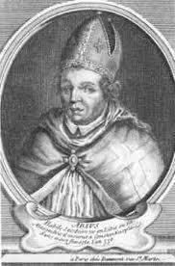
Why the Nicene Creed?
In 319, Arius said “If the Father begat the Son, then he who was begotten had a beginning in existence, and from this it follows there was a time when the Son was not.” HERESY
Major disputes broke out in the Church
Long series of councils ending with the Council of Trent 1545–1563
Church had to take a stand on their beliefs
Notes:
“In former times, the church was attacked by enemies and strangers from without. Today those who are natives of the same country, who dwell under one roof and sit down at table together, fight with their tongues as if with spears.”
And those who say “There was a time when he was not” and “He did not exist before he was made” and “He was made out of nothing” or those who pretend that the Son of God is “of another hypostasis or substance” or “created” or “alterable” or “mutable,” the Catholic Church anathematizes.

Slide 3
Heresy
Deliberate and obstinate denial by a baptized person of any truth which must be believed as a matter of divine and Catholic faith
Grave sin and incurs excommunication (Canon 1364)

Slide 4
What are some modern day heresies?
Notes:
See note page of the five

Slide 5
Modern Heresy: Scientism
Reality is restricted to what only science can explain
If science cannot explain it or demonstrate it, it cannot be real
EXPLAIN THIS:
“Science explains all of reality” in itself is a non scientific claim
World is made up of things that cannot explain themselves adequately – points to God (miracles that occur in medicine)

Slide 6
Ecclesial Angelism
Church must be utterly perfect in every way
Everyone through the history of the Church must be perfect
EXPLAIN THIS:
Church is both divine and human
“We hold a treasure in earthen vessels” – St. Paul
Example: Priest sex scandal does not take away the validity of the Gospel message

Slide 7
Biblical Fundamentalism
Bible read in the literalistic way
The Bible explains events in an unrealistic way, therefore, faith is based off of a lie
EXPLAIN THIS:
Different genres in the Bible
Bible is not one book – but many books in one
Notes:
NOT PRESENTED TO CLASS

Slide 8
Marcionism
Disregard the OT because God was cruel
Embraces only the NT
EXPLAIN THIS!
Must read the Bible in light of Jesus Christ
God is fully revealed in Jesus
OT stories can be applied to one’s own spiritual life
God is like a parent – at times he roars and praises
The people’s understanding of God grew as time went on
Notes:
NOT PRESENTED TO CLASS

Slide 9
Modernism
Distracting men with the allure of materialism
Draws men out of the religious conversation
New virtues are freedom from morality, tolerance to everything but historical Christianity, and material progress
Attempts to kill the Church not with open warfare but by drowning her voice with the drown of busyness
It’s message to the Church:
You DO NOT MATTER.

Slide 10
“ To whom shall I speak? Whom shall I warn, and be heard? See! Their ears are uncircumcised, they cannot give heed; See, the word of the Lord has become for them an object of scorn, which they will no have.” – Jeremiah 6:10

Slide 11
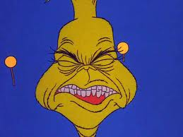
NOISE…NOISE…NOISE
Those who live in a city see an average 5,000 ad messages a day (NY Times)
The average American is exposed to 500 to 1,000 commercial messages a day (University of Washington)
Half of teens send a minimum of 50 texts per day (CNN)
6 million songs have been sold on itunes (Philnotes from Apple)
Teenagers listen to roughly 2.5 hours of music a day

Slide 13
Look at your own schedule…
Wake Up
Breakfast
School
Lunch
Practice
Homework
Friends
Family
Chores
Clubs
Work
TV/Movies
Work Out
Dinner
Bedtime

Slide 15
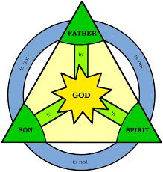
Trinity
Creed is organized by persons of the Trinity
one God in 3 persons
Communion of persons

Slide 17
Eternity
GOD
Time
Past
Present
Future
Notes:
St. Augustine answered, “Nothing. He didn’t have the time.”
Time and space are things that exist for creatures, but not for the Creator.
God is omnipresent – he is everywhere. God cannot move because that implies that there is somewhere where he is not.
Space cannot contain God.
Same with Time. God fills all of time. For God, the past, present, and the future are one simultaneous moment. One eternal present.

Slide 18
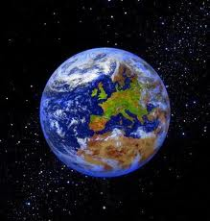
I believe in one God, the Father almighty, maker of heaven and earth, of all things visible and invisible.
God is…
omnipotent (all powerful)
If God is all powerful,
why is there evil?

Slide 19
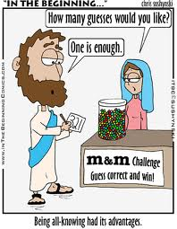
I believe in one God, the Father almighty, maker of heaven and earth, of all things visible and invisible.
God is…
omniscient (all knowing)
Why do we pray to God if He knows everything already?
If God knows what’s going to happen, does that mean he controls what we are going to do?

Slide 20
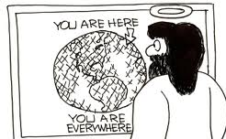
I believe in one God, the Father almighty, maker of heaven and earth, of all things visible and invisible.
God is…
omnipresent (always present) – eternal
God has no beginning and no end

Slide 21
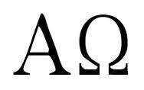
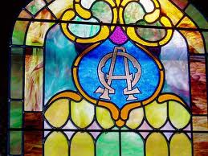
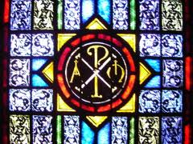
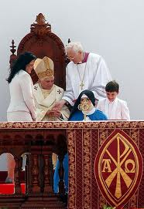
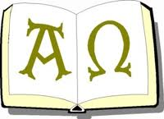
God is the Alpha and the Omega

Slide 22
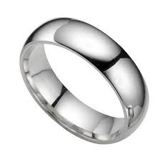
No Beginning and No End

Slide 23
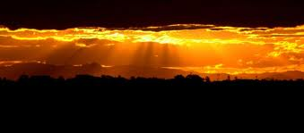
God from God, Light from Light, true God from true God, begotten, not made, consubstantial with the Father;
Arius believed that Jesus was a creature that God created – Jesus wasn’t always present
“Light from Light” is a way to describe Jesus and the Father
Light rays (Jesus) is continuously streaming forth from the sun (Father)
Rays are from the sun but there is not a time when there is a sun without rays
We only know the sun through the rays of light it emits (we know the Father through the Son)
Notes:
A favorite analogy of the Athanasians was the following: Light is continuously streaming forth from the sun. (In those days, it was generally assumed that light was instantaneous, so that there was no delay at all between the time that a ray of light left the sun and the time it struck the earth.) The rays of light are derived from the sun, and not vice versa. But it is not the case that first the sun existed and afterwards the Light. It is possible to imagine that the sun has always existed, and always emitted light. The Light, then, is derived from the sun, but the Light and the sun exist simultaneously throughout eternity. They are co-eternal. Just so, the Son exists because the Father exists, but there was never a time before the Father produced the Son. The analogy is further appropriate because we can know the sun only through the rays of light that it emits. To see the sunlight is to see the sun. Just so, Jesus says, "He who has seen me has seen the Father." (John 14:9)

Slide 24
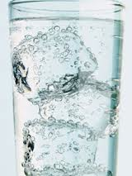
Consubstantial
Consubstantial means “of one essence”
+ Used in Council of Nicaea in 325
Jesus and God the Father are of the same substance

Slide 25
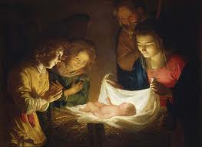
Through him all things were made. For us men and for our salvation he came down from heaven, and by the Holy Spirit was incarnate of the Virgin Mary, and became man.
Jesus’ name means “God saves”
We need to be saved….from what?

Slide 26
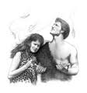
Epic Fail – Gen 3
We were made all good and immortal
Adam and Eve were tempted
They disobeyed God
Sin and death entered the world
We moved farther from God – there was a break between us
God tried to bring us closer to him by bringing us into promises with him
We kept on breaking those promises
Jesus was the only one who could help bring us closer to God and repair that break
Notes:
Read Gen 3 out loud

Slide 27
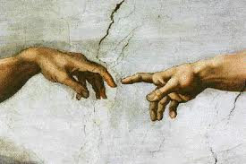
Notes:
Circle the break – that is what Adam and Eve do to separate their relationship with God
Jesus comes to pull it back together. Jesus is that space between God and man

Slide 28
Fully God and Man
Hypostatic Union – Jesus was fully God and fully man (1 person, 2 natures)
(Hypostasis means, literally, that which lies beneath as basis or foundation)
Felt emotions
“And Jesus wept” (John 11:35)
“As he drew near, he saw the city (Jerusalem) and wept over it (Luke 19:41)
“And when he does find I, he sets it on his shoulders with great joy” (Luke 15:5)
“And I am glad for you that I was not there…” (John 11:15)

Slide 29
WHERE DOES SUFFERING COME FROM?

Slide 30
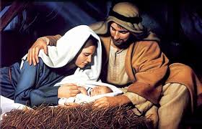
More Human or Divine?
Notes:
Spectrum line

Slide 31
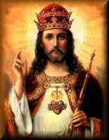
More Human or Divine?

Slide 32
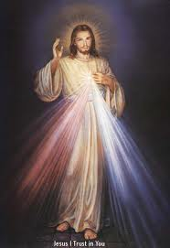
More Human or Divine?

Slide 33
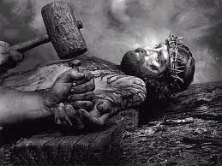
More Human or Divine?

Slide 34
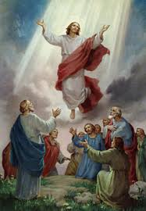
More Human or Divine?

Slide 35
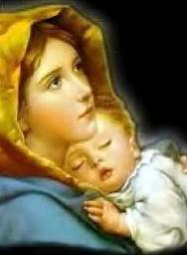
Virgin Mary
Mary is a perpetual Virgin
She was “immaculate” meaning without stain
The Immaculate Conception was Mary conceived without sin
She is known as the Mother of God “theotokos”
She is the perfect model of how to live

Slide 36
Taken from Pastor Fred
Dear brothers and sisters, it's not too hard to see. These folks are still more pagan than Christian. Only now, their favorite goddess is Mary, the mother of Jesus. They try to be politically correct and say things like, "We don't pray to Mary, we just give her homage or ask her to run off and take our prayers to Jesus when He's too busy to hear them." Well, what the heck's the ding dang difference? Catholics are no better than pagans or Wiccans, praying to stone statues and trees. Even if they aren't in fact praying to Mary, which they are, Jesus is very clear in Luke 4:8 when he says,
"You shall do homage to the Lord your God; Him alone shall you adore." In fact, Jesus' mother just got in the way most of the time. In Mark 3:31-35, we learn, "There came then his brethren and his mother, and, standing without, sent unto him, calling him. And the multitude sat about him, and they said unto him, Behold, thy mother and thy brethren without seek for thee. And he answered them, saying, Who is my mother, or my brethren? And he look round about on them which sat about him, and said, Behold my mother and my brethren! For whosoever shall do the will of God, the same is my brother, and my sister, and mother." It doesn't stop there friends.
Did you know that Catholics are so darn stupid they believe that Mary was a virgin until the day she died? I guess they never read about what happened when Jesus visited his home town in Matthew 13:55-56 and all his old neighbors proclaimed, "Is not this the carpenter's son? is not his mother called Mary? and his brethren, James, and Joses, and Simon, and Judas? And his sisters, are they not all with us?" You see! Mary had a whole litter of kids! Everyone in Nazareth knew it. But them Pope-lovin', candle-lighting, ring-kissin' Catholics deny it!
Notes:
BAD LINK – DO NOT SHOW TO STUDENTS
http://www.landoverbaptist.org/sermons/dangcatholics.html

Slide 37
Why is Mary Important?
Adam sinned with the help of Eve just as Jesus redeemed the world with the help of Mary (protoevangelium)
Honor and praise were given to Mary at the visitation
henceforth all generations shall call me blessed
Jesus worked his first miracle at his mother’s request
Jesus addresses his mother as “woman” which is an ancient term directed toward a queen or woman of high rank
"Be imitators of me, as I am of Christ" (1 Cor 11:1, also Phil 3:17, 1 Cor 4:16).
Peter and Paul given healing power –Jesus heals, but they are given Christ’s power
Notes:
Given Power in Acts 19:11-12

Slide 38
“He (St. Joseph) knew her not till she brought forth her first-born son” (Matthew 1:25).
It is important to recognize the old use of the word “until”
expresses what has occurred up to a certain point and leaves the future aside
EXAMPLES: “I am till you grow old” (Is. 46:4)
Would God leave them after they grow old?
God the Father said to His Divine Son: “Sit Thou at My Right Hand, until I make Thy enemies Thy footstool” (Ps. 109)
Would the Son lose his place at the right hand?

Slide 39
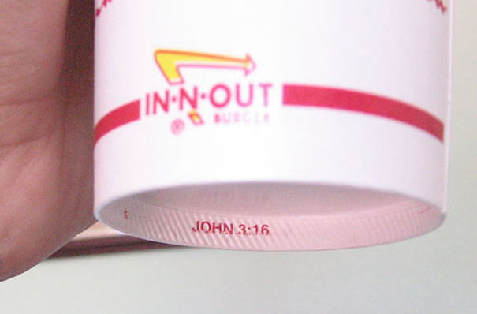
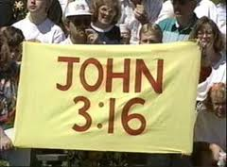
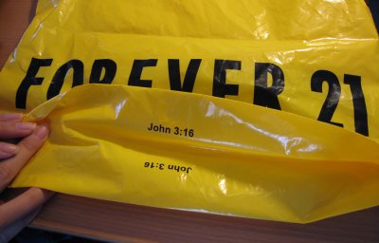

Slide 40
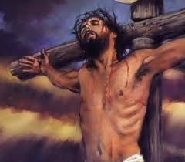
For our sake he was crucified under Pontius Pilate, he suffered death and was buried,
Crucifixion was the method of execution under the Romans
Pontius Pilate was the governor
Romans accused Jesus of
________________
Jews accused Jesus of
________________
Jesus suffered – fully
human
Notes:
Use Mark Hart – Jesus suffered along with us

Slide 41
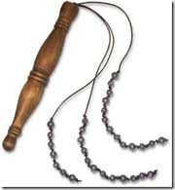
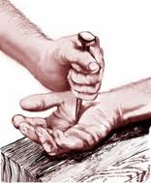
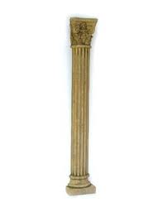
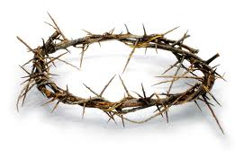

Slide 42
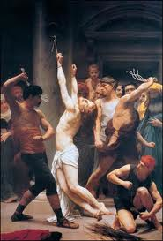

Slide 44
What if Jesus didn’t rise from the dead? How would things be different?

Slide 45
and rose again on the third day in accordance with the Scriptures. Resurrection Claim
Liar
Lunatic
Truth-Teller

Slide 46
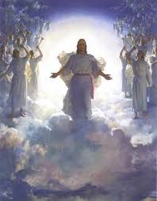
He ascended into heaven and is seated at the right hand of the Father. He will come again in glory to judge the living and the dead and his kingdom will have no end.

Slide 47
675 Before Christ's second coming the Church must pass through a final trial that will shake the faith of many believers. The persecution that accompanies her pilgrimage on earth will unveil the "mystery of iniquity" in the form of a religious deception offering men an apparent solution to their problems at the price of apostasy from the truth. The supreme religious deception is that of the Antichrist, a pseudo-messianism by which man glorifies himself in place of God and of his Messiah come in the flesh.

Slide 48
Read Rev 19:11

Slide 49
Holy Spirit
How do we know the Holy Spirit exists?
Story of Jesus’ baptism, Elizabeth and Simeon, Jesus conceived by Mary
Whenever God sends his Son, he sends his spirit
Pentecost – Gives birth to the Church (Acts 2-8)
http://www.vatican.va/various/basiliche/san_pietro/vr_tour/Media/VR/St_Peter_Apse/index.html

Slide 50
Filioque
Latin for “and the Son” used in the Latin Church
H.S. proceeds from BOTH the Father and the Son
Distinct person of the Trinity
Break between the Catholics and the Greek Church

Slide 51
How do we see the Holy Spirit?
Explain how you know that the wind is there
We cannot see it, but we see the effects
Advocate
Paraclete

Slide 52
Marks of the Church
ONE
HOLY
CATHOLIC
APOSTOLIC

