Slide 1
How to talk to parents of different faiths…
Or no faith at all
Nathaniel Stevens
Catholic Speaker, Evangelist, Apologist
Facebook: Fidei Defensor Green Bay

Slide 2
I am a Boomerang…

Slide 3
Sept 18, 2011; Easter Vigil 2012

Slide 4
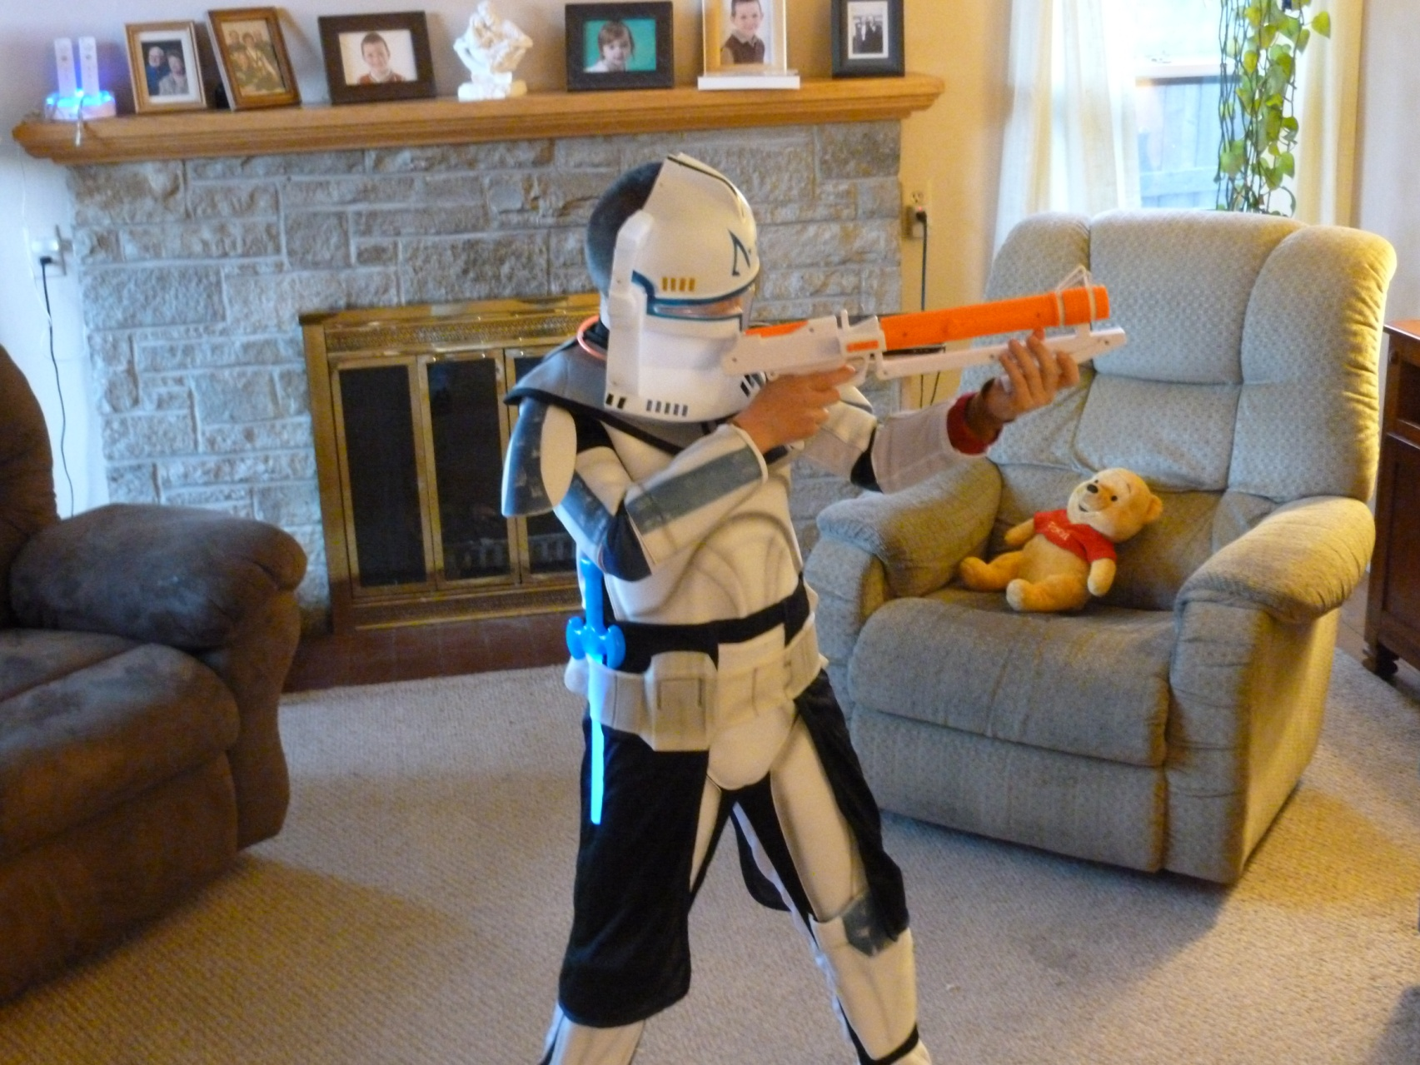
I’ve been that parent…

Slide 5
I’ve been that parent…

Slide 6
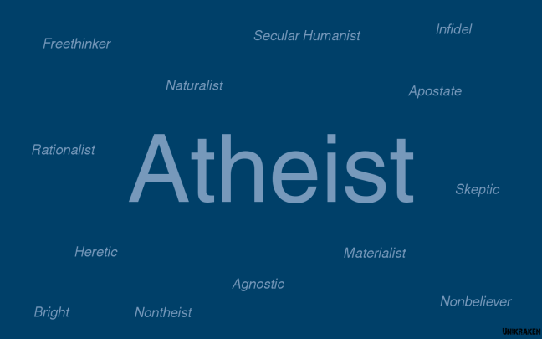
What kind of parents are we talking about?
Non-Catholic Christian Denomination
Non-Christian Religions
Atheist
Lapsed / Lax / Fallen away Catholic
The last two are most likely

Slide 7
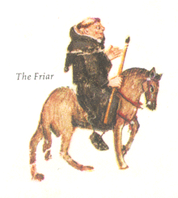
I Follow What St. Francis Said…
“Preach the Gospel Boldly; Only when necessary use words.”

Slide 8
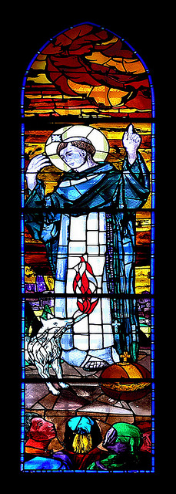
Houston, we have a problem…
St. Francis never said it…
St. Francis was all about preaching:
Sultan, animals
It’s not a bad saying if …
Means I will speak to others about the faith, but I MUST live it daily.
Against Scripture and the Church if…
I don’t have to say anything as long as I’m living it.

Slide 9
Isn’t talking about our faith just a Protestant thing?
Catholics aren’t supposed to do this, are we?

Slide 10
Documents of Vatican II / Catechism
“The whole Church is missionary and the work of evangelization [is] the fundamental task of the people of God.” (Decree on the Missionary Activity of the Church)
Catechism Paragraph 848:“…the Church… has the obligation and also the sacred right to evangelize all men.”
Paragraph 905:“Lay people also fulfill their prophetic mission by evangelization…”

Slide 11
What if I don’t know the answer?
“I don’t know, BUT I’LL FIND OUT FOR YOU.”

Slide 12
We shouldn’t be forcing our ideas on others!
They can have their beliefs and we can have ours.

Slide 13
Self Refuting…
“We should not force our ideas / religion on anyone.”
We don’t “force”, we invite to a better way
Self-refuting statement
“I can’t speak any English.”
“Don’t Tolerate Intolerance!”
“They can have their beliefs we can have ours.”
Self-refuting: is this belief supposed to be held by both of us?

Slide 14
Relativism…
The belief that truth is relative; objective truth does not exist.
“What’s true for you is true for you; what’s true for me is true for me.”
“You have your truth and I have mine.”
Is it Absolutely True, that there are No Absolute Truths?
It has infected almost every aspect of our life

Slide 15
Objective truth does exist…
Should a Senior in High School believe in Santa Clause?
It makes them feel good
It makes them act good
So why not?
It’s not True.
There is a better way to live and believe.

Slide 16
Do we want people living the best way possible?
Living conditions?
Relationships?
Psychologically / Emotionally?
Why not Spiritually?

Slide 17
Authentic Catholicism is the Best way to live.
Don’t believe me? Ask me afterward.
Don’t worry, I don’t bite…

Slide 18
Ok, Ok, So How do we do this?
Nuts and Bolts of Talking to People about the Faith.

Slide 19
It’s not as hard as you think…
Be converted yourself
Pray, Pray, Pray! Engage in Catholic prayers and practices:
LIVE IT JOYFULLY is a MUST!
Monthly reconciliation
Adoration
Attend Mass more than once / week
Rosary / Chaplet
Saint devotion (St. Justin Martyr, St. Francis De Sales, Bl. Fulton Sheen, G.K. Chesterton)

Slide 20
Read Scripture and Catechism…
Daily!
You’ve heard of “Play 60”
Try “Read 20”

Slide 21
Know where to find what Catholic Church actually teaches
Find, read accurate resources
www.Catholic.com
the Catholic Catechism
Imprimatur, Nihl Obstat
“…if you are sure you are a… corrector of the foolish, a teacher of children… You then, who teach others, will you not teach yourself?” Romans 2:19-20

Slide 22
Eight Laws of Effectively Sharing the Faith, by Terry Barber
Keep it Simple
Keep them saying ‘yes’
Be enthusiastic / start w/ positive statement
Call them by name
Show and then tell
Always agree / rephrase their position
Ask questions / Socratic method
Practice Virtue

Slide 23
A few more, by Nate
Active Listening
Try to understand / Let them speak / Logical errors
Take your time
One issue at a time
Never become argumentative
Different then presenting an argument
Be Humble
Does not mean be a door mat

Slide 24
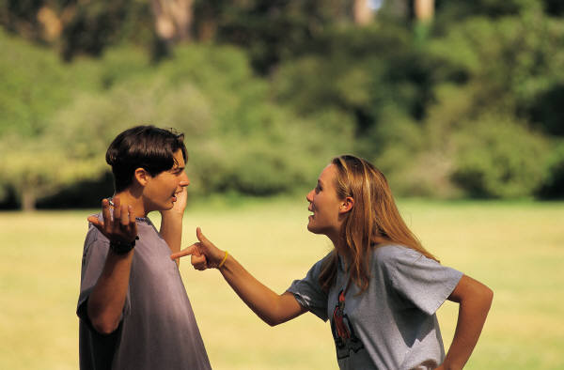
How NOT to talk about the Faith…

Slide 25
Do NOT:
Win at all costs…
“It is entirely possible to win the argument but lose the soul.” – Bl. Arch Bishop Fulton Sheen
Sacrifice Truth for palatability
Does not allow for an informed choice
Different from “only what they can handle”
Use your ‘But’
I know what the Catholic Church teaches… but…
We are called to use our hands, heads and hearts… not our ‘but’s

Slide 26
If you’re having difficulty with some teaching…
Read from Catechism
Read from Church documents
Read faithful writings – books essays
Especially by people who struggled with the same issue(s)
Pray: Jesus, what is it YOU want me to believe about this?
I will follow whatever you tell me.

Slide 27
Explaining the Faith
Three questions; Three different people;
Three answers with kindness and respect

Slide 28
“Mary, Mother of God?” How Could God have a Mother?
Question from a non-Catholic Christian

Slide 29
Who is Jesus?
If A=B and B=C then C=A
Is Mary the Mother of Jesus?
Is Jesus just a Man?
If Jesus is God and His Mother is Mary then Mary is the Mother of God
Where is this in Scripture?
“Who am I that the Mother of my Lord should come to me?” Lk 1:43
Is 7:14 cf Mt 1:23: “Behold a virgin shall conceive and bear a son and will name Him Immanuel which means ‘God is with us’.”

Slide 30
Theotokos = “God Bearer”
“Behold a virgin [Mary]…
…shall conceive and bear a son and will name him…
Immanuel which means ‘God is with us’.”
“A virgin [Mary] shall bear God.”
“Theotokos”

Slide 31
The Protestant Reformers Professed it.
Martin Luther, John Calvin and Ulrich Zwingli

Slide 32
Religion is totally disproved by Science.
Question from an Atheist

Slide 33
Do you believe Science shows us the answer to everything?
Isn’t this a philosophical statement?
Can you prove this idea using the Scientific Method alone?
Or the 5 senses alone?
Isn’t it true that everything that had a beginning had something outside itself that began it?
A non-existent tree can’t say, “I think I’ll exist today.”
Doesn’t modern scientific evidence show the Universe had a beginning? (Big Bang Theory)
All time, space, matter and energy.

Slide 34
What began the Universe?
It would have to be outside of:
Time, Space, Matter and Energy
Nothing can begin itself

Slide 35
Why does the Catholic Church hate gay people?
Question from lax / lapsed Catholic

Slide 36
Have you read what the Catholic Church actually teaches?
CCC 2357 and 2358:
“They [people with Same Sex Attraction (SSA)] must be accepted with respect, compassion and sensitivity. Every sign of unjust discrimination in their regard should be avoided”
“This inclination [SSA]…is objectively disordered…”
“…’homosexual acts are intrinsically disordered.’ They are contrary to the natural law. They close the sexual act to the gift of life. They do not proceed from a genuine affective and sexual complementarity. Under no circumstances can they be approved.”

Slide 37
People vs Behavior
The ACTS are intrinsically disordered
So are the ACTS of fornication, adultery, theft, idolotry etc.
The INCLINATION is objectively disordered
“Disordered” means leading away from God
We are supposed to be “ordered” towards God
Any inclination towards sin is “objectively disordered”

Slide 38
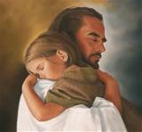
What does the Catholic Church say about the people?
Compassion
Accepted
Respected
Cannot discriminate against
Loved
Wanted
No organization has done more for people with AIDS and HIV
The Catholic Church had AIDS and HIV outreach before the US ever knew about it.

Slide 39
What do Catholics with SSA say about Catholic teaching?
Daniel Mattson, Living with Same Sex Attraction
‘Catholic Answers’ pod cast
The Catholic teaching about Same Sex Attraction is the most loving, tolerant, accepting and respectful position.
Better than the LGBT position

Slide 40
How would I answer me…

Slide 41
If You have Questions…
Please ask me… or put it on the “Stump the Chump” card.

