Slide 1
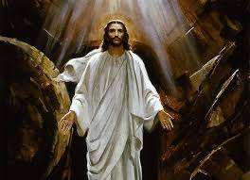
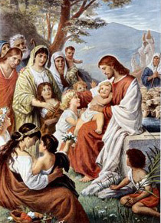
Safe Environment
Grades 4 - 6
March & April
2016

Slide 2
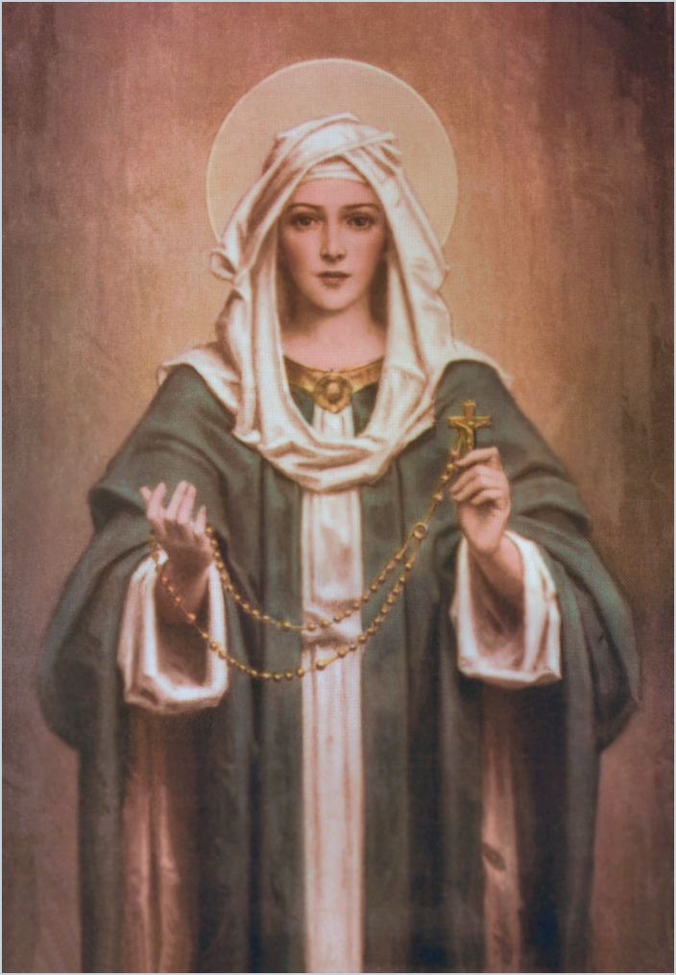
Memorare
Opening Prayer
Remember, O most gracious Virgin Mary, that never was it known
that anyone who fled to thy protection,
implored thy help, or sought thine intercession was left unaided.
Inspired by this confidence,
I fly unto thee, O Virgin of virgins, my mother;
to thee do I come, before thee I stand, sinful and sorrowful.
O Mother of the Word Incarnate, despise not my petitions,
but in thy mercy hear and answer me. Amen.

Slide 3
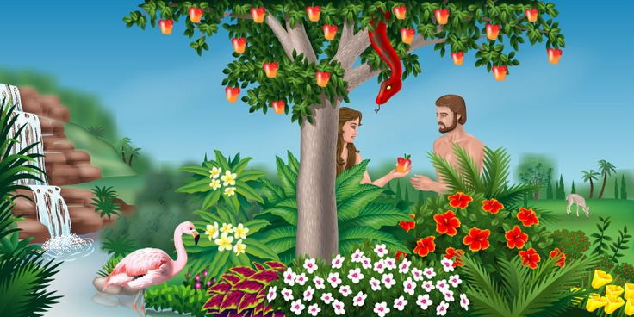
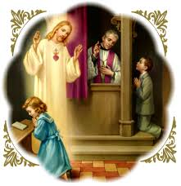
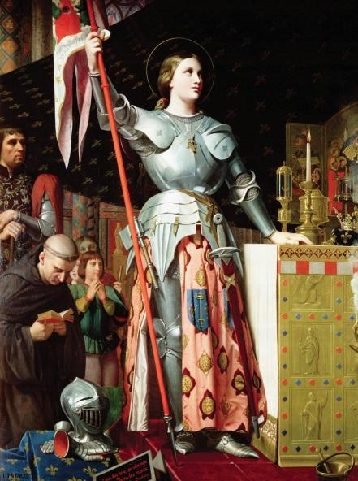
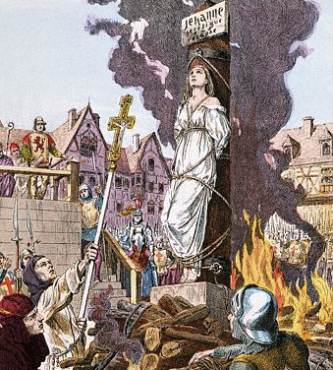
some actions and behaviors are wrong or sinful
Devil Tempts us away from God
Creation Story
Devil’s plan
Don’t need to listen to the devil
Confession
Virtue
Fortitude - Have the courage to do what is true and good even when it is difficult
Saint
St. Joan of Arc

Slide 4
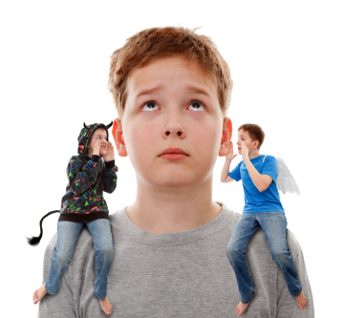
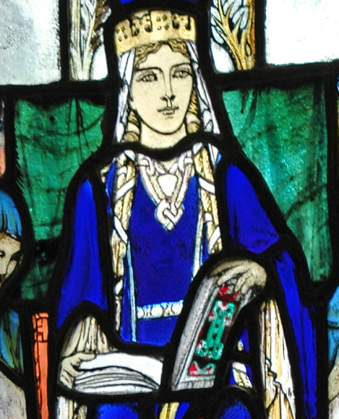
God gave us the gift of free will
Free will is our ability to choose
Responsibility comes with freedom
Freedom to do good or bad
No one should ever touch your private parts
God taught us that Modesty is important
We become Tabernacles
Different types of touches
Safe, Unsafe, Unwanted
Virtue
Responsibility - fulfilling one’s just duties: accepting the consequences of your words and actions
Saint
St. Margaret of Scotland

Slide 5
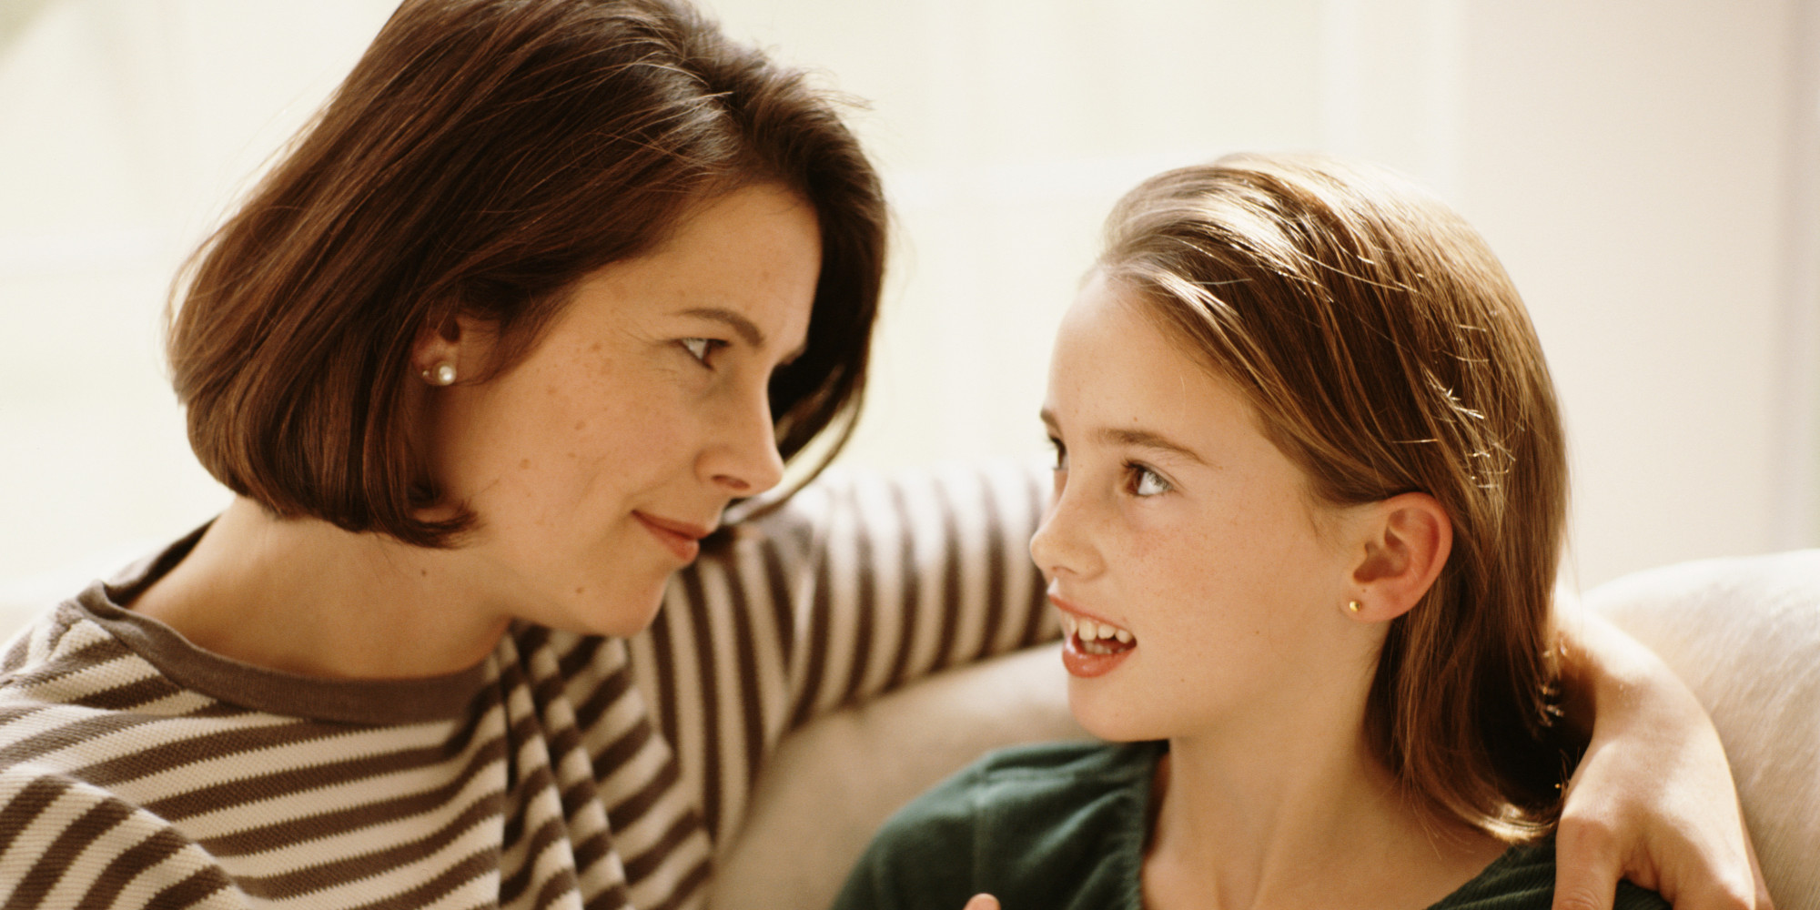
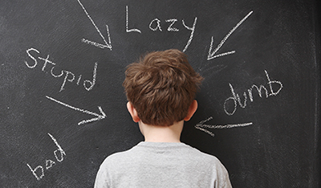
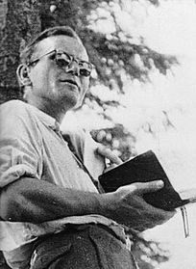
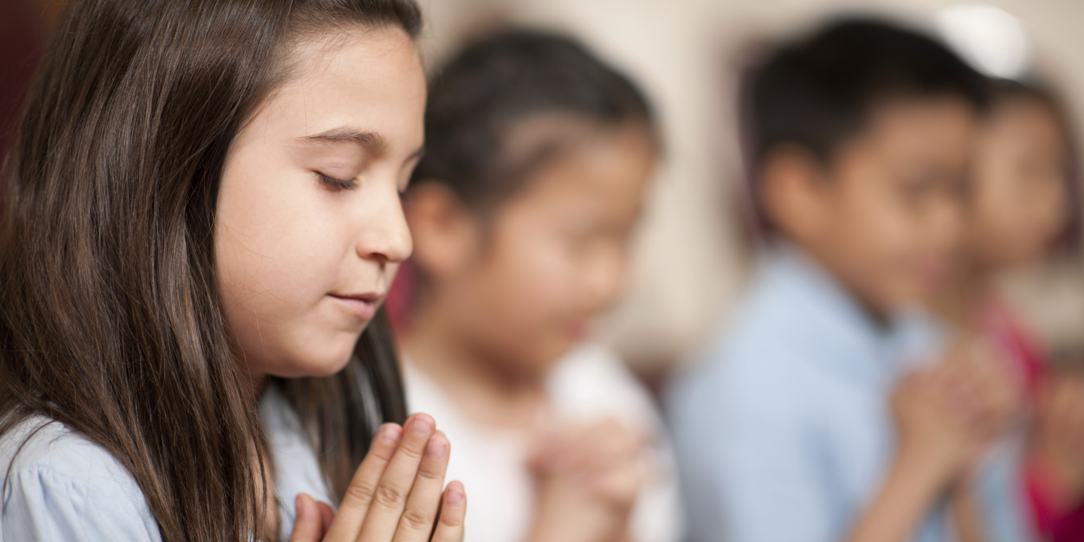
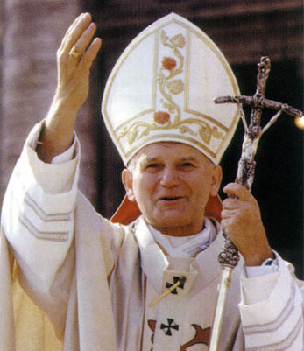
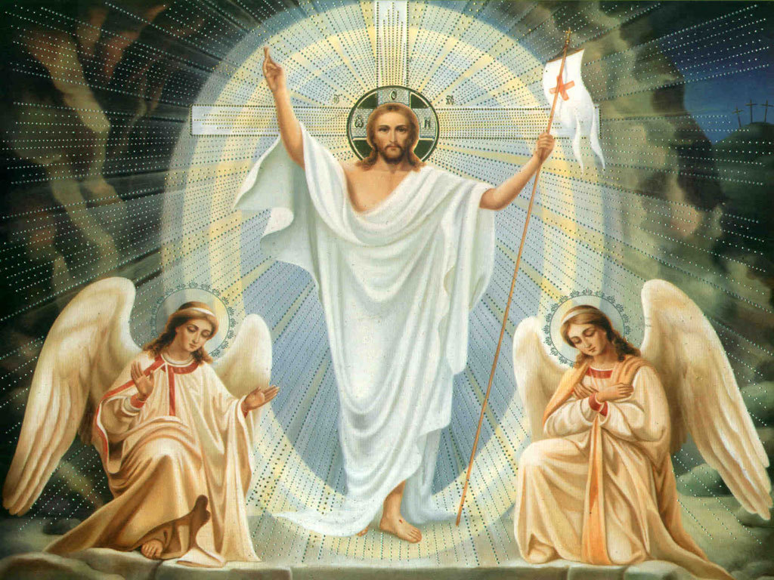
recognize, trust, and follow your instincts
Image and Likeness - You are to be respected as a child of god
Parent Communication - Opening and Frequently
Emotional Abuse
Talk to someone
Virtue
Circumspection - careful consideration of circumstances and consequences. You seek advice, silently reflect upon circumstances and consequences of your actions
Saint
St. Pope John Paul II
Notes:
Main Objective:
Say “no” with confidence. (R.7.1.E.2)
Recognize that it is the best thing to tell a trusted adult when you are uncomfortable or feel unsafe. (R.7.1.E.4)
Teaching
Ask: Who made you? (review question) Students raise their hand. Call on one. (Correct Answer: God)
Ask: Why did God make you? (review question) Students raise their hand. Call on one. (Correct Answer: To know, love, and serve him)
Say: God created you beautiful and good. He created you out of love. God loves us and so should other people. Other people are called to respect you.
Ask: How do others respect you? Students raise their hand. Call on one. (Answers may vary, but some examples might include doing nice things for you, smiling, helping you when we need help, helping you come closer to God, listening to you)
Say: Jesus loves you so much regardless of the good or bad things you do.
Say: Sometimes, people don’t respect us the way Jesus respects us. Sometimes, people can be mean or they do things that make us feel uncomfortable. If you are ever in a situation that makes you feel unsafe, what should you do? Students raise their hand. Call on one. (Correct Answer: Say “no” and go to a trusted adult)
Say: If anyone ever makes you feel uncomfortable or unsafe, you just say “no” and walk away to a trusted adult and tell them what happened.
Hand each student a piece of paper and have them trace their hand. Say: When something unsafe happens, you are to go to a trusted adult. List one trusted adult on each of your fingers. You should have five people total that you are comfortable going to and talking with. (Examples could include: Dad/Mom, teacher, Grandpa/Grandma, a friend’s parent, coach, etc)
Ask: Why do you feel safe with these five people? Students raise their hand. Call on one. (Answers may vary, but some examples might be that they look out for their good, they love Jesus, they make good decisions, they are present and help me when I need help, they pray with me, etc).
Go through a few examples of situations where you would say “no” and tell a trusted adult:
If someone is following you
If someone is trying to get you to go with them
If someone you don’t know is trying to give you a ride
If someone you don’t know is knocking at the door
If you see something bad on the computer
Say: There are different kinds of friends. Use worksheet 5 to identify different types of friends.
After the students have had the ability to draw their friends, ask why one of their friends they drew is a friend (Answers may be because they are kind, help me, make me laugh, bring me closer to Jesus, etc)
Say: Friends are important to bring you closer to Jesus and keep you safe.
Vocabulary: Good judgment, trusted adults, friends
Objectives NOT Used
Say “no” with confidence. (R.7.1.E.2)
Recognize that it is the best thing to tell a trusted adult when you are uncomfortable or feel unsafe. (R.7.1.E.4)

Slide 6
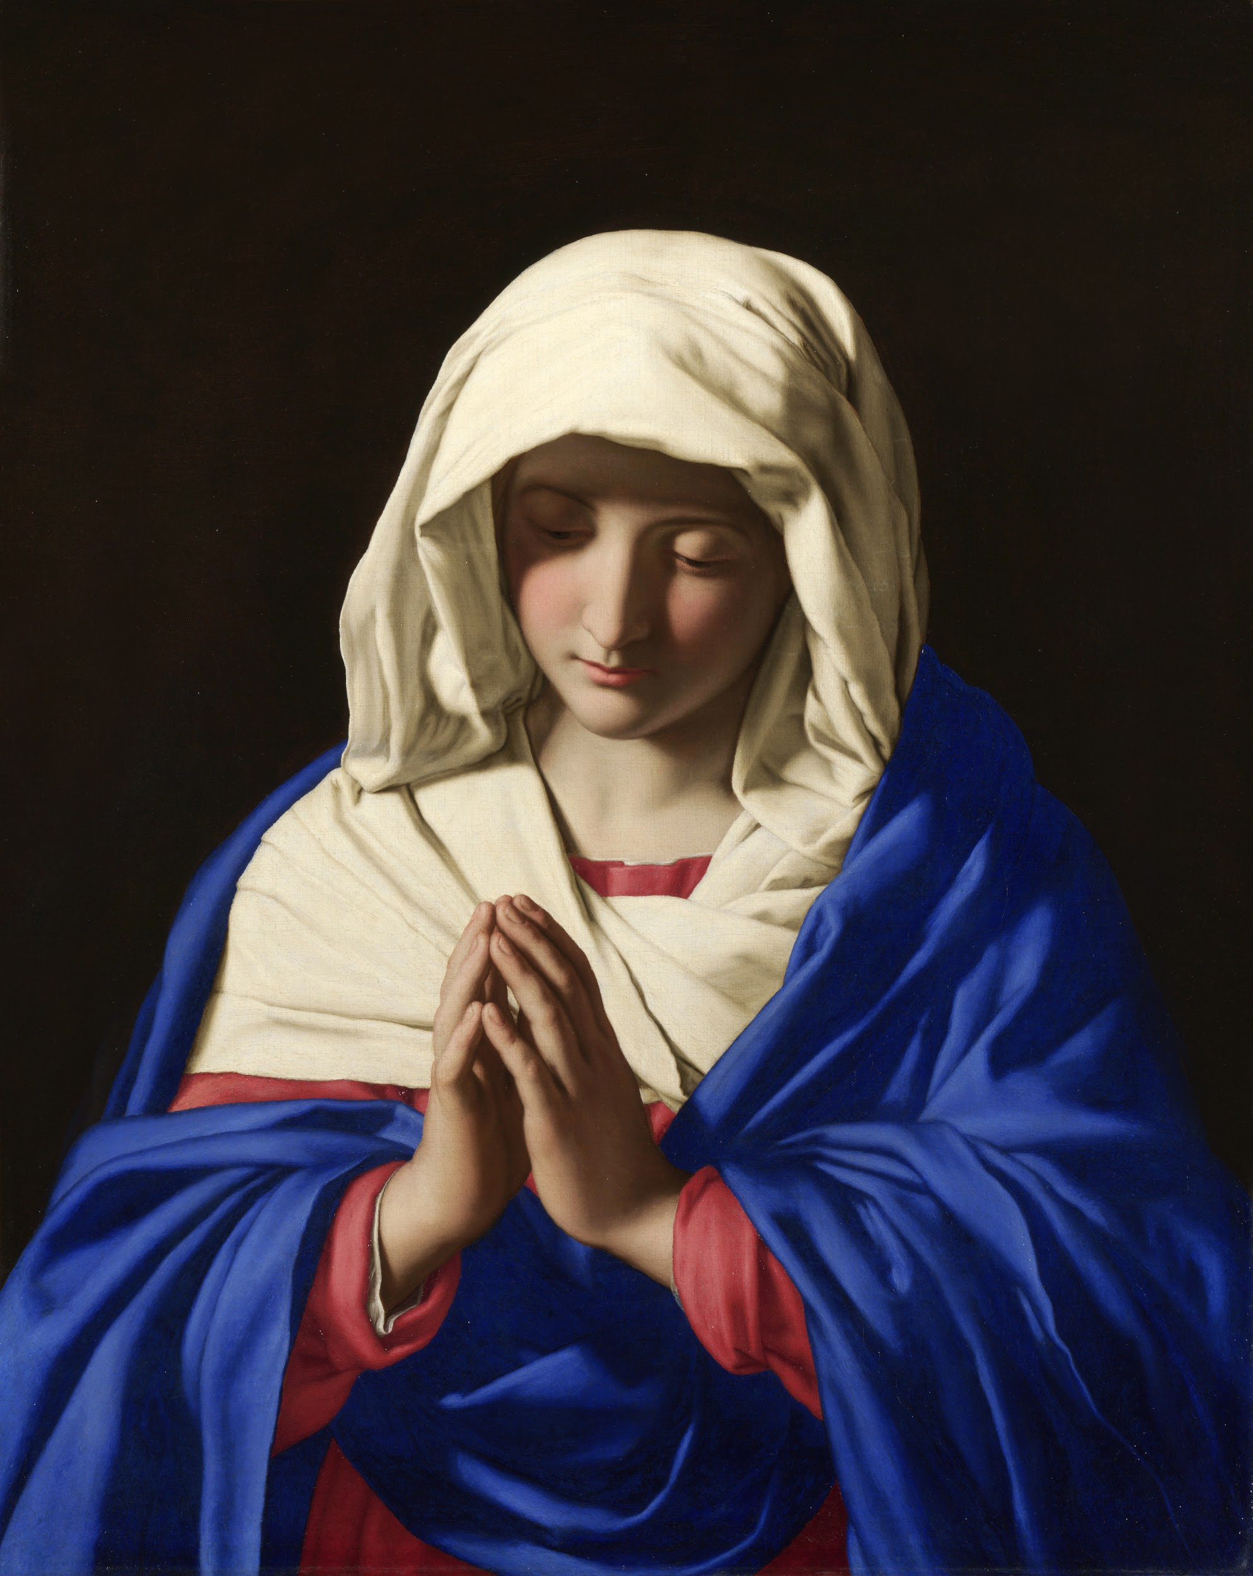
So what did we talk about???
some actions and behaviors are wrong or sinful
God gave us the gift of free will
recognize, trust, and follow your instincts

Slide 7
Back in your Classroom...

Slide 8
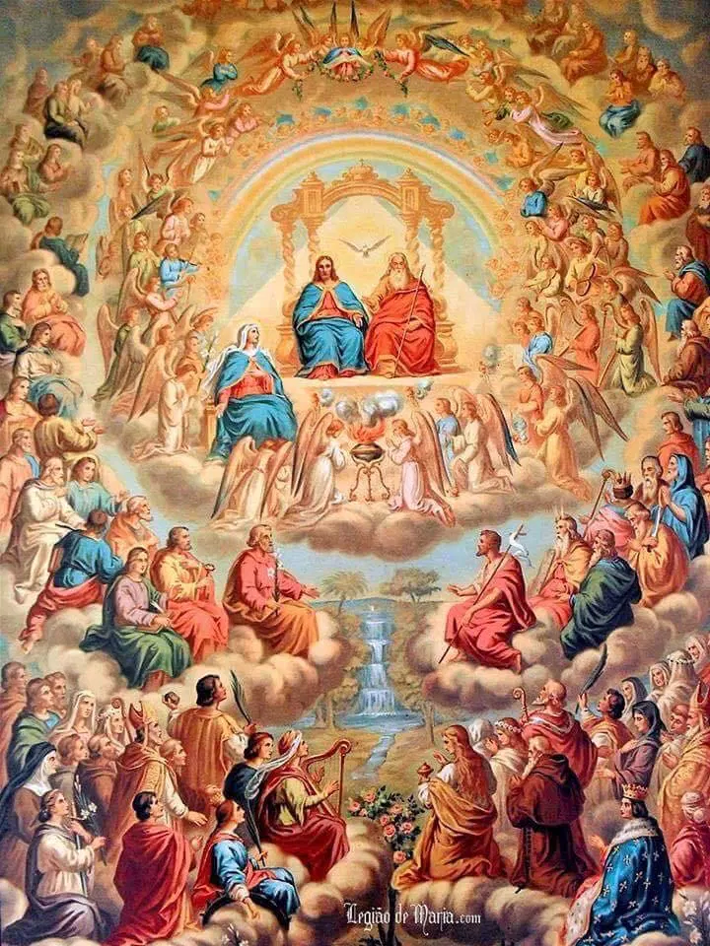
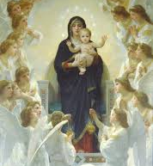
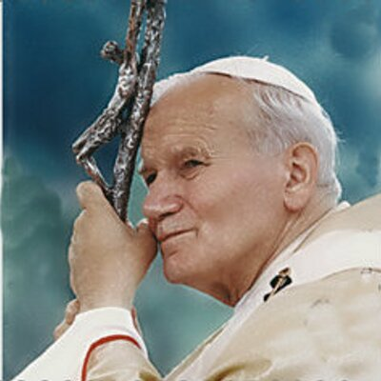
Memorare
Closing Prayer
Remember, O most gracious Virgin Mary, that never was it known
that anyone who fled to thy protection,
implored thy help, or sought thine intercession was left unaided.
Inspired by this confidence,
I fly unto thee, O Virgin of virgins, my mother;
to thee do I come, before thee I stand, sinful and sorrowful.
O Mother of the Word Incarnate, despise not my petitions,
but in thy mercy hear and answer me. Amen.

