Slide 1
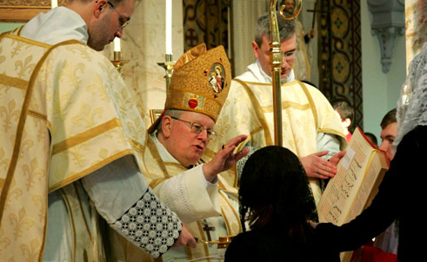
10 Things to Remember about Confirmation Prep
(It starts a lot earlier than you think)

Slide 2
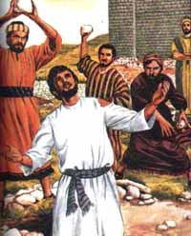
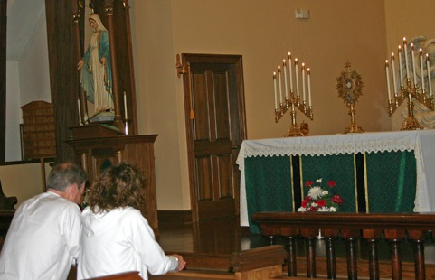
Acts 6:8 “And Stephen, full of grace and power, did great wonders and signs among the people.”
1. Be in love with Jesus and live every day for Him.
In order to be in love with Jesus, teachers need to know He is a person – not just an idea or way of life
Praying to Him must be as vital to your life as the air you breathe
See Jesus, sit with Jesus, love him
Immerse yourself in Scripture
Frequent the sacraments

Slide 3
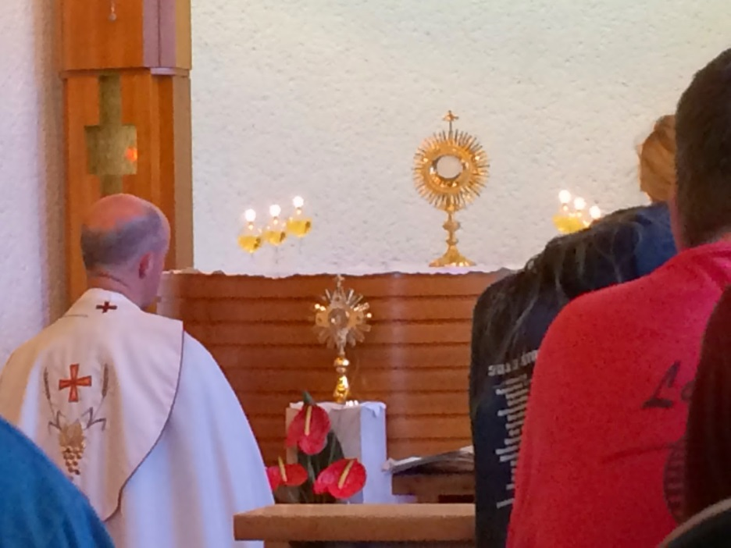
Jn 1:40-42a “One of the two who heard John speak, and followed him [Jesus], was Andrew, Simon Peter’s brother. He first found his brother Simon, and said to him, ‘We have found the Messiah’ ... He brought him to Jesus.”
2. Bring students to Jesus intentionally
Speaking about Jesus is not enough
EX: The president is in the next room and instead of seeing him, you talk about him instead
We must go to him
If we really believe the Eucharist is Jesus, we must glean our strength from His presence
Bringing students to Jesus in the Blessed Sacrament is one of the greatest gifts you can give your students

Slide 4
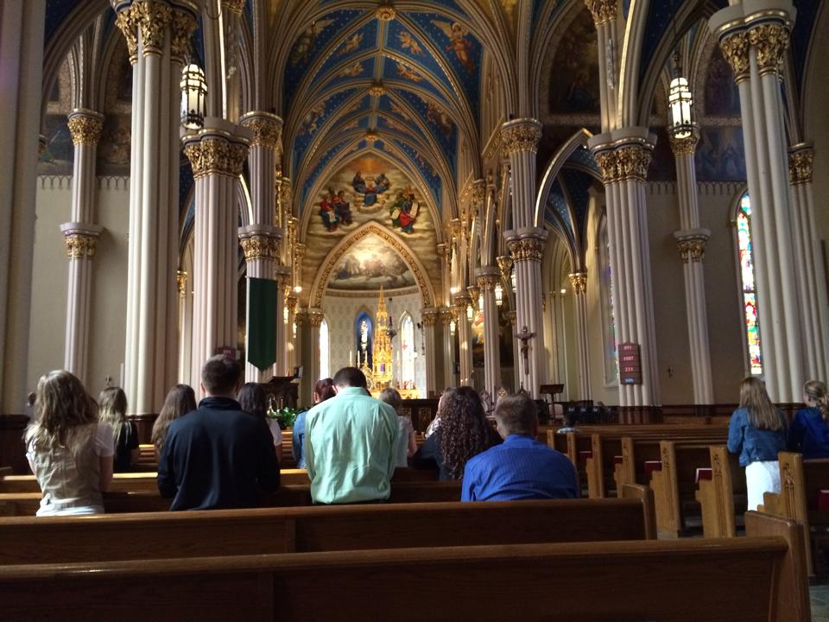
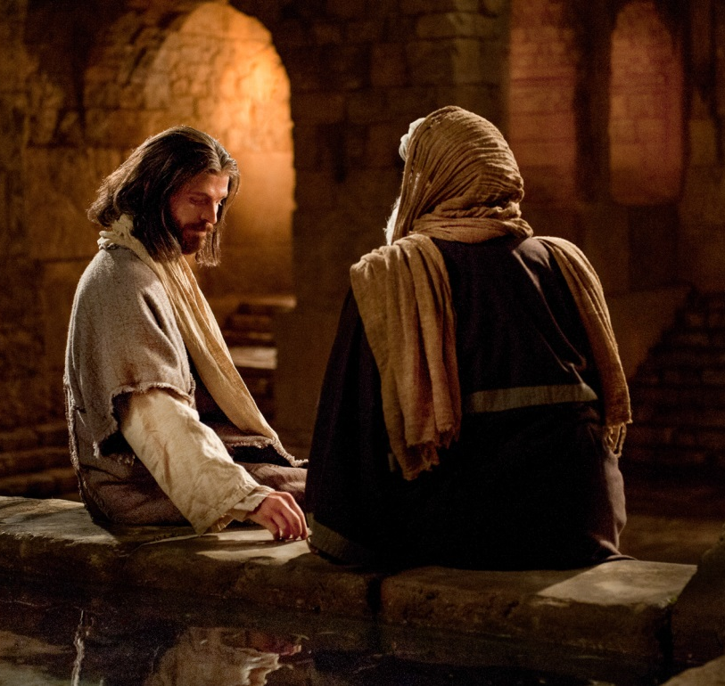
Jn 3:5-6 “ Jesus answered, ‘Truly, truly, I say to you, unless one is born of water and the Spirit, he cannot enter the kingdom of God. That which is born of the flesh is flesh, and that which is born of the Spirit is spirit.’”
3. Don’t overlook the big questions.
Where am I going?
Why does this matter?
And we need to know this because…?
Always put it into perspective
A relationship with Jesus takes work but its worth it if its put into perspective
Holiness is the goal – in this lesson, did I say the name of Jesus once?

Slide 5
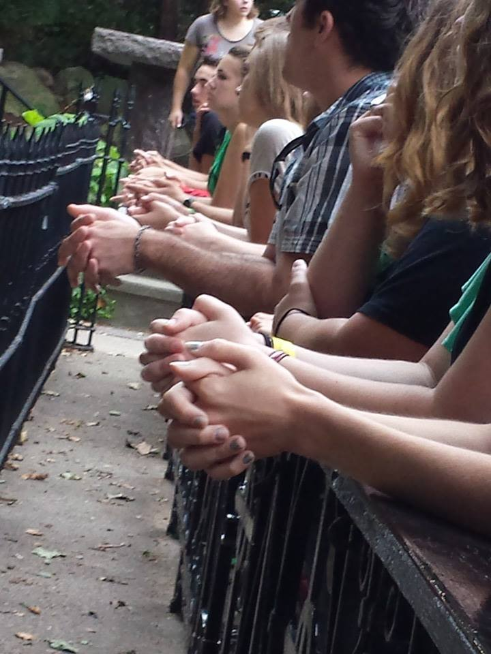
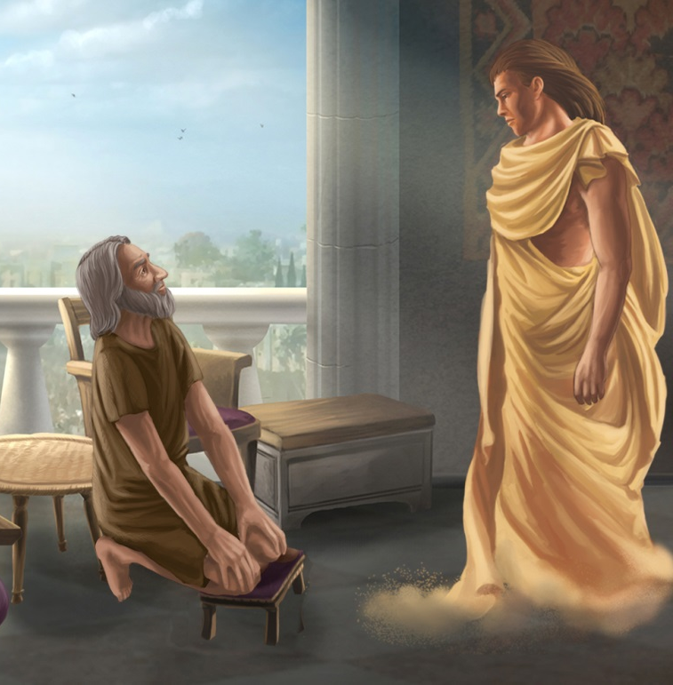
Dan 9:21-23 “ … while I was speaking in prayer, the man Gabriel, … came to me in swift flight at the time of the evening sacrifice…he said to me, ‘O Daniel, I have now come out to give you wisdom and understanding. At the beginning of your supplications a word went forth, and I have come to tell it to you, for you are greatly beloved; …’”
4. Direct students in their personal prayer life.
How exactly do I pray?
Why don’t I hear God?
The goal is to have students develop a relationship with Christ so strong that prayer becomes a part of their daily existence
Praying in class helps model prayer, but how are students learning to pray on their own?

Slide 6
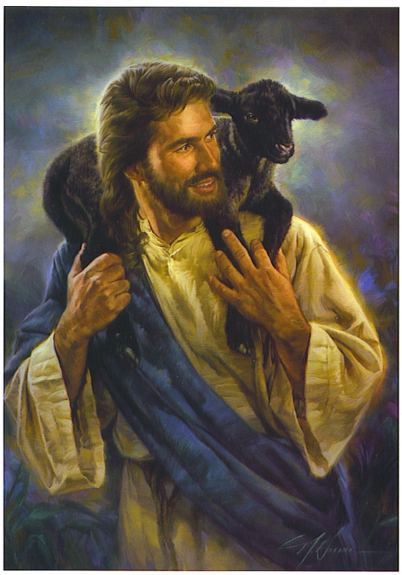
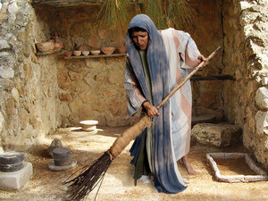
Luke 15:4, 8 “What man of you, having a hundred sheep, if he has lost one of them, does not leave the ninety-nine in the wilderness, and go after the one which is lost,…?” and “Or what woman, having ten silver coins, if she loses one coin, does not light a lamp and sweep the house and seek diligently until she finds it?
5. Distinguish effective male and female learning.
Males and females learn differently
Know the way in which they retain information
Provide varying witness talks to each gender specifically
Capitalize on time they can spend alone with their specific gender groups
Men are underrepresented in the Church especially. What can we do to vary the teaching styles?

Slide 7
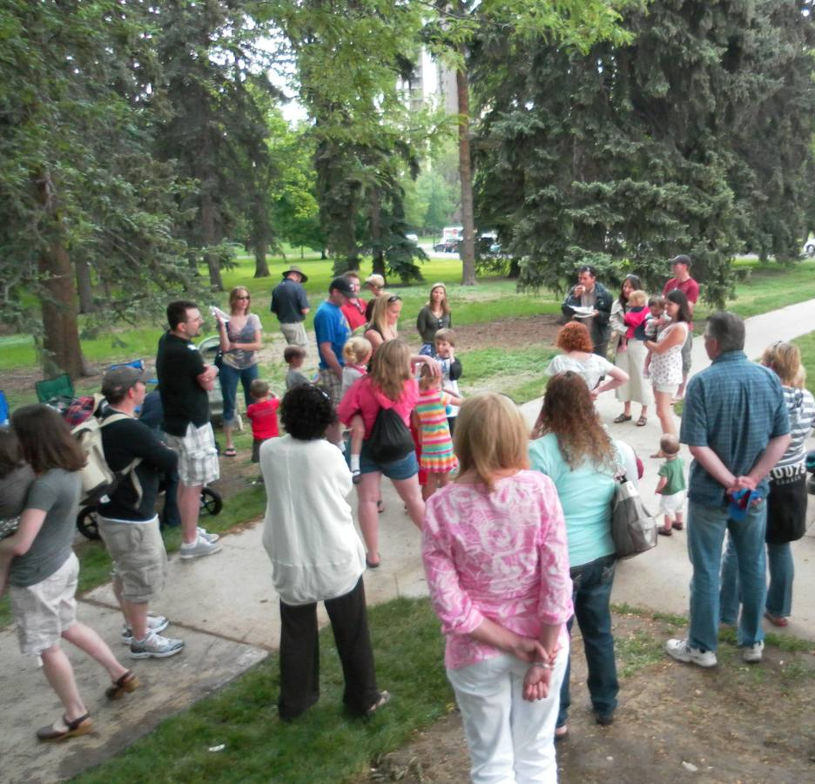
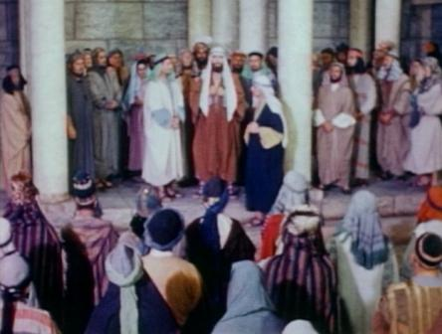
Acts 2:46-47 “Day by day, attending the temple together and breaking bread in their homes, they partook of food with glad and generous hearts, praising God and having favor with all the people. .. the Lord added to their number day by day those who were being saved.”
6. Introduce family mentoring.
Families are the first educators
Many parents haven’t been taught how to effectively raise their children in the faith
Many schools use a mentoring system which pairs an active Catholic family with 3-5 other families.
This builds relationships, encourages Mass participation, and allows for witnessing to happen naturally

Slide 8
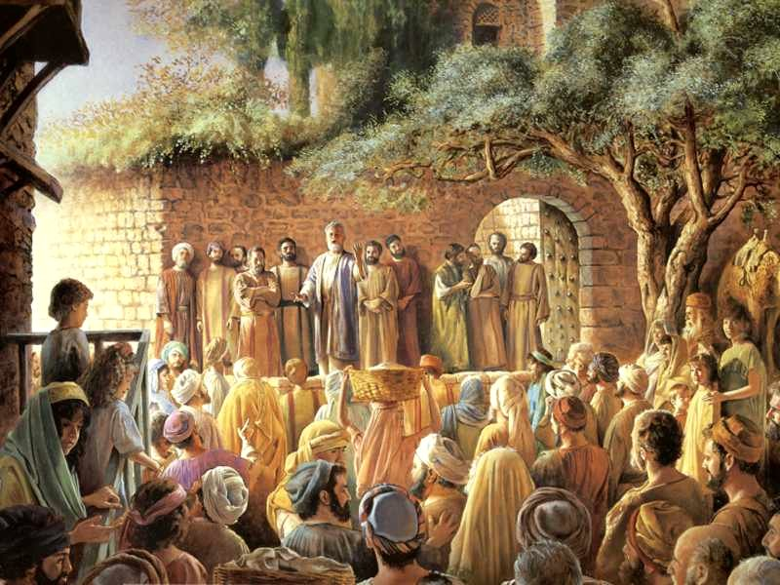
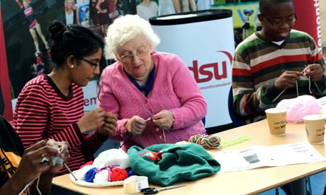
Hebrew 10:24-25 “… and let us consider how to stir up one another to love and good works, not neglecting to meet together, as is the habit of some, but encouraging one another, and all the more as you see the Day drawing near.”
7. Connect the students to the parish.
The parish just doesn’t run on its own
What can the students be introduced to so that they are intrigued to continue volunteering?
It begins with relationships

Slide 9
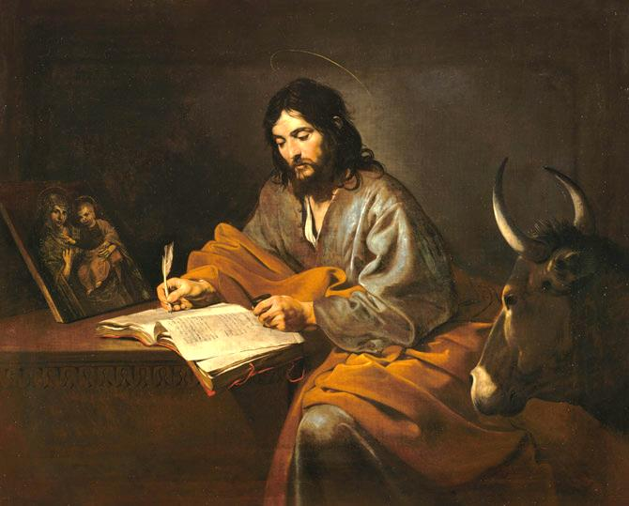
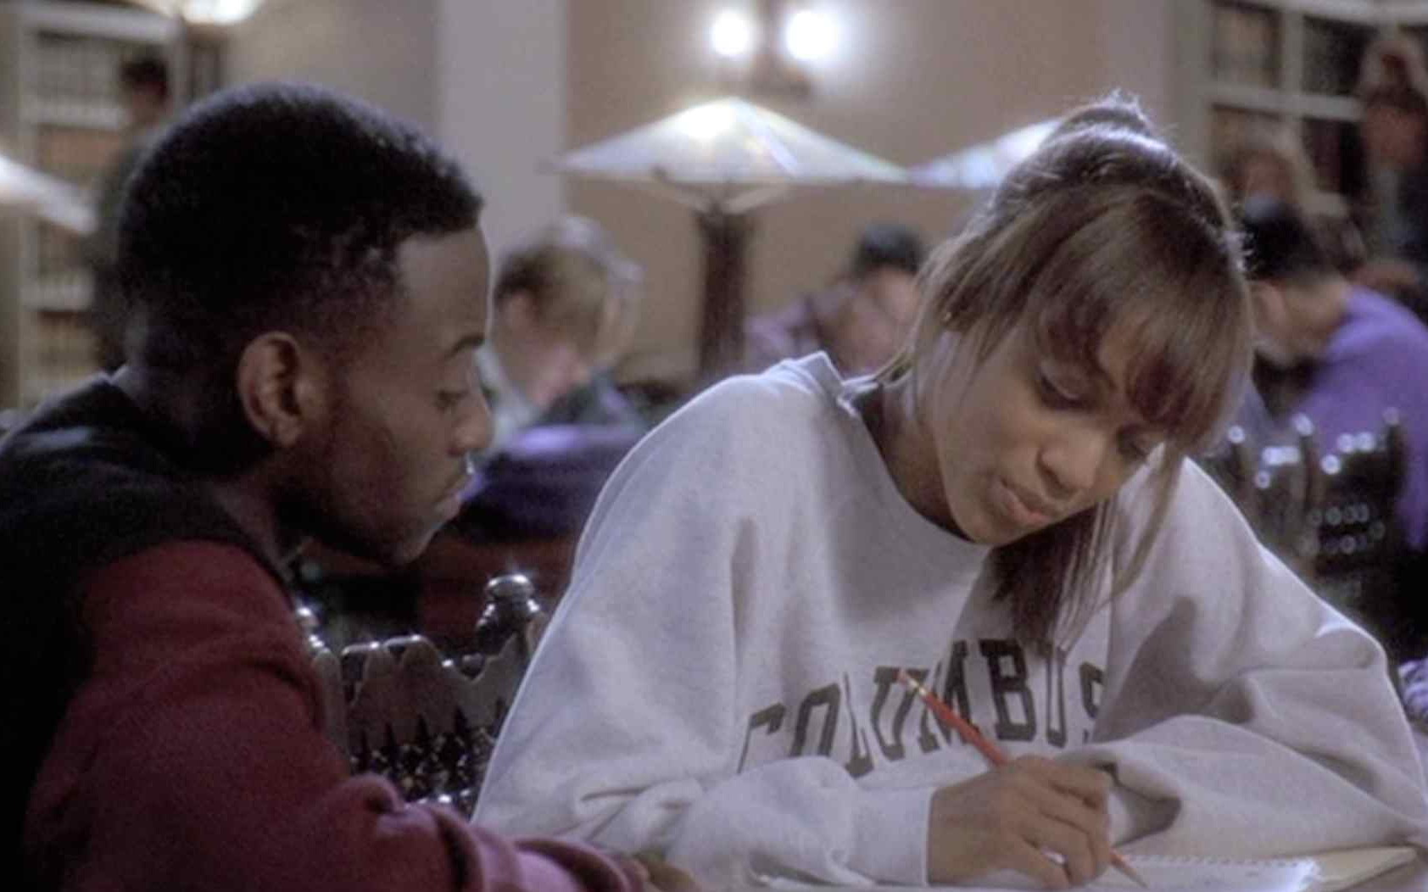
Jn 20:30-31 “Now Jesus did many other signs in the presence of the disciples, which are not written in this book; but these are written that you may believe that Jesus is the Christ, the Son of God, and that believing you may have life in his name.”
8. Don’t insult their intelligence.
Students read about complexities in science and math
They can surely comprehend tough vocabulary and mysterious realities
Don’t’ make them feel inadequate or make theology seem like a solely subjective pursuit for no apparent reason

Slide 10
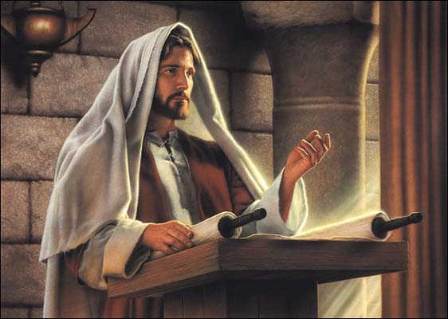
Luke 4:16 – 20 And he [Jesus] came to Nazareth, … ; and he went to the synagogue, as his custom was, on the sabbath day. And he stood up to read; and there was given to him the book of the prophet Isaiah. He opened the book and found the place where it was written, ‘The Spirit of the Lord is upon me …”
9. Remember that books change lives.
Books can be read at all ages
Send students home with the lives of the saints and other books of appropriate grade level to the families
Don’t be afraid to have students read quietly in class
St. Augustine, St. Ignatius, St. John Paul II were changed by books

Slide 11
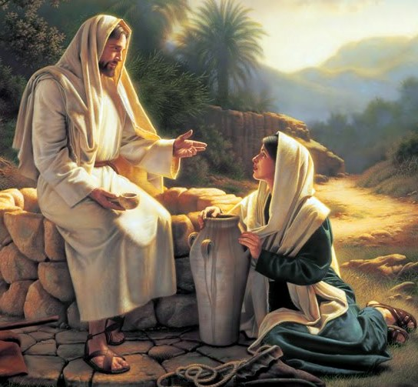
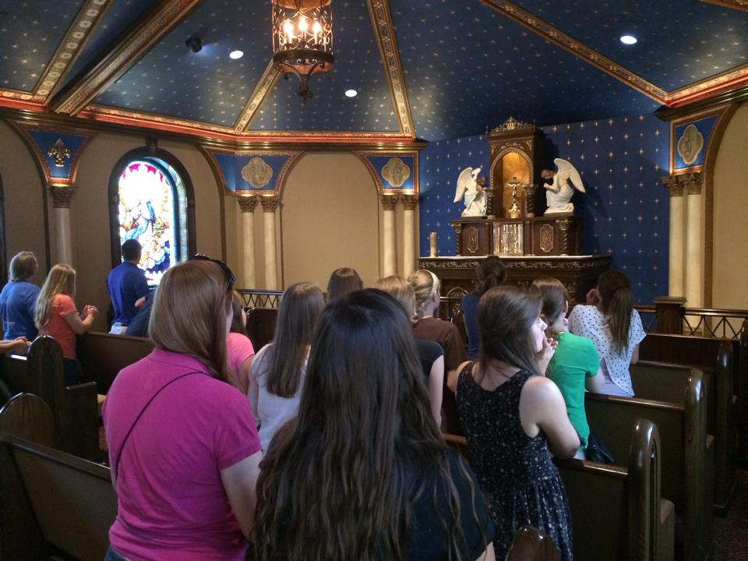
Acts 4:39-41 Many Samaritans from that city believed in him because of the woman’s testimony, ‘He told me all that I ever did.’ So when the Samaritans came to him, they asked him to stay with them; and he stayed there two days. And many more believed because of his word.”
10. Bring students to the feet of Jesus during each retreat.
What is the goal of the retreat – always leads to building a stronger relationship with Jesus
Sacramental components?
Prayer time?
Retreat should be a retreat from the world – what is different about this retreat from the rest of the world?

